Slide 1
EDITING / VIEWING / PRINTING / DELETING A QUARTERLY CONVERSATION IN EPMA
This section will review how to edit, view, delete and print an existing Quarterly Conversation.

Slide 2
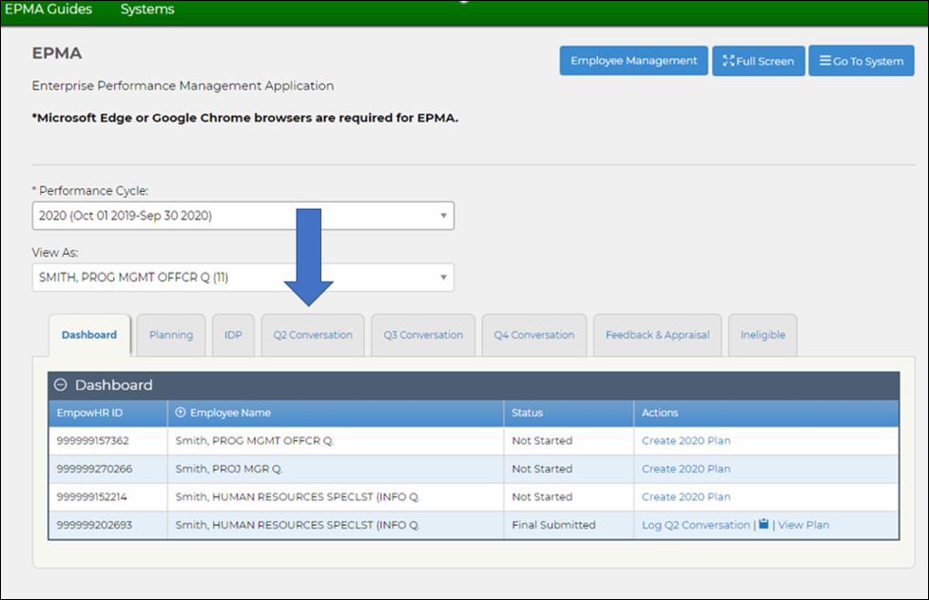
Step 1. From the EPMA homepage, click on the Q2 Conversation tab.

Slide 3
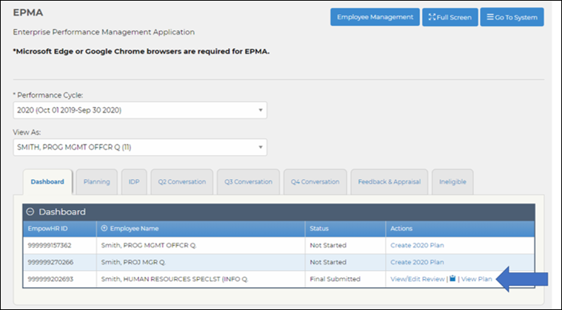
Step 2. Click on the View Plan action.

Slide 4
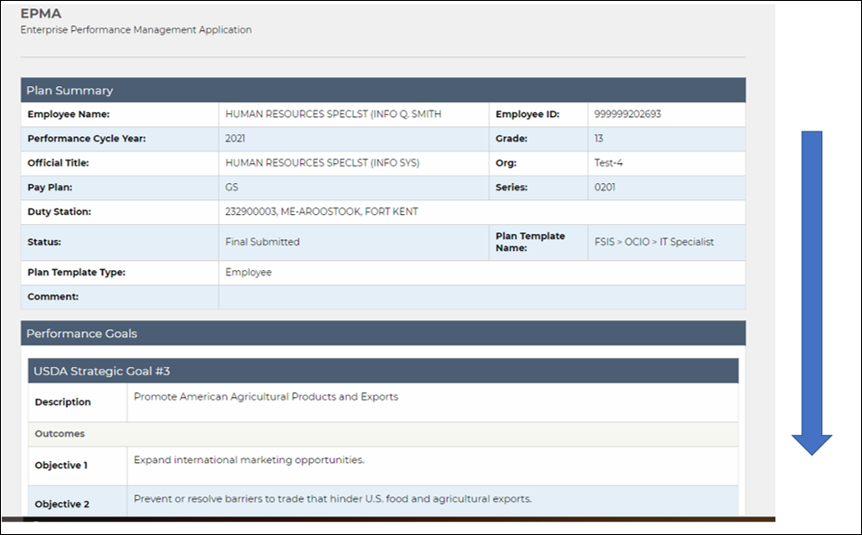
Step 3. Scroll down to the bottom of the View Plan page.

Slide 5
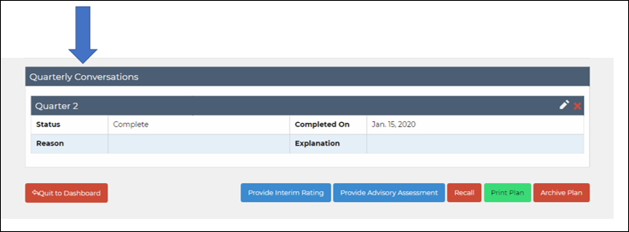
Step 4. The Quarterly Conversations can be found at the bottom of the View Plan page in the Quarterly Conversations table. This will list out all of the Quarterly Conversations completed for the employee's plan.

Slide 6
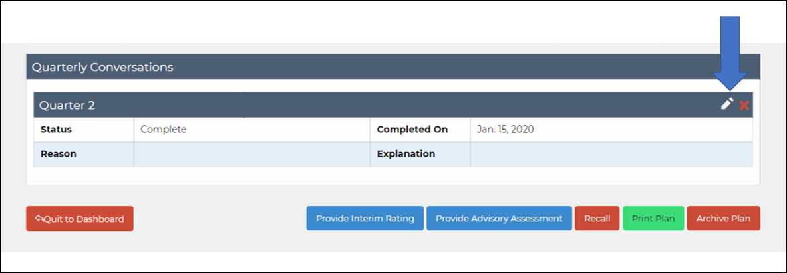
Step 5. Click on the pencil icon to edit the Quarterly Conversation.

Slide 7
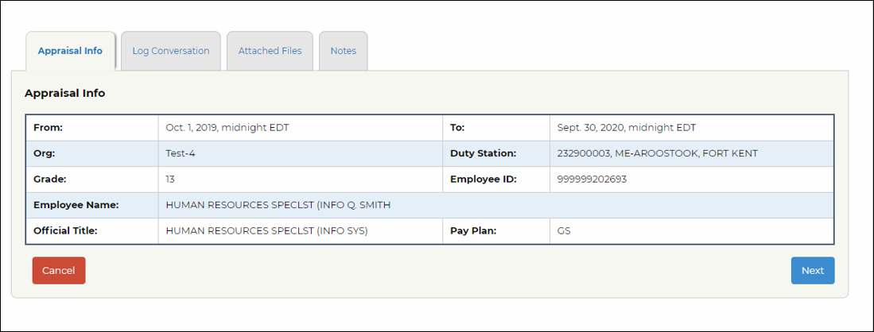
Step 6. The Quarterly Conversation pop-up box will appear. From here you can make changes on the tabs and click Log when complete

Slide 8
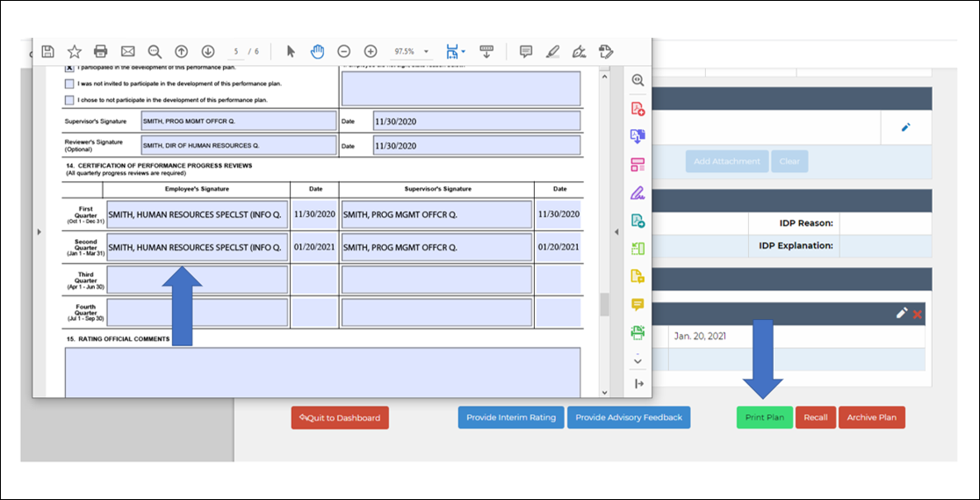
Step 7. Clicking the Print Plan button will generate the AD-435 form with the Quarterly Conversation fields pre-populated.

Slide 9
Step 8. Click the red X to delete the Quarterly Conversation. This may be needed if it was logged for the incorrect employee and needs to be removed.

Slide 10
Step 9. Click Delete Quarterly Conversation to confirm. The Quarterly Conversation will be removed from the employee's plan once confirmed.

