Slide 1
Foreign National Process Midwest Area
Christina Brown
July 25, 2022

Slide 2
Agenda
Introduction of Foreign Nationals
Process for the Midwest Area
Name Traces
215s & Memos
Q&A

Slide 3
Introduction
USDA ARS and its client agencies bring in an average of 700 foreign nationals per year to work with USDA and/or to visit USDA facilities.

Slide 4
Process for Midwest Area

Slide 5
Old Process
215s and memos were being sent for signature before names traces began.
Name trace was completed.
215s would need to be completed again, post name trace.
215s and memos were sent back to unit.
215s and memos were not being housed correctly.

Slide 6
Current Process
Name trace to be submitted through the AFM Customer Service Portal
Technology Transfer Coordinator, Renee Wagner, will review any information and may ask for corrections
After approval from Technology Transfer Coordinator, will go to Associate Area Director, Jay Johnson, for final approval
Once 215s and memos are returned to location, they must be uploaded back onto the original name trace ticket (unprotected by password)
AFTER name trace is completed, 215s and memos to be sent to the area office after all signatures obtained.

Slide 7
Name Trace

Slide 8
What Requires a Name Traces? Any Foreign National to USDA facilities that include the following:
May be visiting ARS or one of the ARS’s client agencies.
May be visitors, contractors, students, volunteers, collaborators or federal employees.
May be short-term or long-term foreign visitors.
May have escorted or unescorted access to facilities.
May or may not have system access.
May or may not be sponsored by ARS or client agencies.
May or may not require assistance acquiring a visa.
Includes legal all permanent residents (green card holders) regardless of residency status.
Includes foreign visitors, previously cleared, who have left the country for 30 or more days.
Includes foreign visitors staying more than five (5) consecutive days or more than five (5) non-consecutive days in a 30-dayperiod
Includes foreign visitors staying five (5) days or less and hands on work/research will be conducted.

Slide 9
What does NOT Require a Name Trace? The following types of non-US Citizens are NOT included in this process:
If the stay is five (5) days or less consecutive days or five or less non-consecutive days within a 30-day period AND the foreign visitor will not conduct any hands-on work/research. Foreign visitors who visit ARS facilities/spaces (even when co-located on a university campus MUST fully complete the visitor log upon arrival. The visitor log shall be retained by the Location (and, as required, provided to the Center or Area) for audit purposes. The foreign visitor log does not need to be reported to Administrative and Financial Management (AFM).

Slide 10
Types of Name Trace Processes
Foreign National Nonfederal – Name Trace Clearance Only
Foreign National Federal Employee – Name Trace Clearance Only
J-1 Contractor Assistance and Name Trace Clearance

Slide 11
Name Trace Process
Open FN/FV portal ticket for Name Trace Clearance through AFMCSP
Foreign National Information must be entered by the location.
Please make sure HR Liaison is chosen so ticket can be assigned and tracked.
Enter ticket information – Generates Letter of Invitation to the foreign national to complete the ARS-230 online.
Current, unexpired passport must be uploaded.
Even if the foreign national is a Green Card holder, FN must have a passport to upload to run name trace
After name trace is complete, an email notification is generated from the portal.
Note: The Office of Area Director does not receive a copy or notification if name trace has been complete, if possible, include name trace email with your 215s and memos. We also do not have access to the portal to see the status or completion of name trace.

Slide 12
215s & Memos

Slide 13
Information to Include in Memo
Use the same name on passport.
Do not use professional name if Foreign National goes by something different.
The full name and location of Unit where the Foreign National will be conducting research.
Country of Origin and Citizenship.
Anticipate dates to be in Unit.
Only one year at a time due to Name Trace needing to be conducted yearly and potential funding issues.
The Project Number, Name and Objectives the Foreign National will be working on
Agreement Number
How ARS will benefit with Foreign National Conducting Research
Signatures Needed
Host Scientist
Research Leader
Center/Lab Director, if applicable or Administrative Officer
Associate Area Director, Jay Johnson

Slide 14
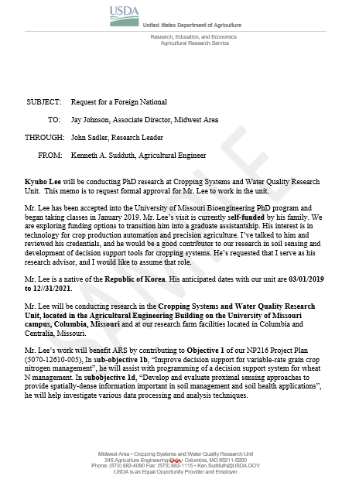

Slide 15
Agreement Number
If the Foreign National is working under an agreement, enter the ARS agreement number associated with the project and the type of agreement (e.g., CA, RSA, RCA, etc.).
You might have more than one agreement for the year, check your agreement dates. If this is the case, you will have more than one 215.
If there is no agreement (or will be no agreements) between ARS and the home institution, or between ARS and the Foreign National’s employer (e.g. University in the United States), at the time the Foreign National will be working in the ARS Facility, enter “NONE” in this box.

Slide 16
215 Blocks #1 - 5
Block 1:
Enter full name that is shown on passport.
Check if Foreign or Domestic Block.
Block 2:
Enter the Country of Citizenship/Permanent Residence.
Enter just the Country Name, not full address.
Block 3:
Enter Date of Birth shown on passport.
Block 4:
Enter dates of agreement that will correspond with the dates of the Foreign National be with ARS.
Check your agreement dates.
Block 5:
This refers to the ARS Facility (Enter the full name of the Unit and Address of the ARS Facility)

Slide 17
215 Block #6
Enter the ARS Research Project Title to which the Foreign National will be conducting research
If the project involves a Cooperative Research Agreement, include the agreement title that matches the agreement number at the top of the page and identity the type of agreement.
If the complete title does not fit, enter as much as possible
If the agreement is a Research Support Agreement (RSA) and not a Cooperative Research Agreement, indicate the RSA number at the top of the page and the funding cooperative research project title and agreement number in block 6, if the project is externally funded.
If the RSA is associated with the D project funding only, enter the D Project Number and title in block 6.
If there is no cooperative research agreement, provide the number ad title of the in-house D Project in block 6.

Slide 18
215 Block #7
Enter the Name and Address of the Foreign National’s Employer/Organization (at the time they will be working in the ARS Facility).
If the Foreign National is NOT employed by another party and has no other organizational affiliations, type N/A here.
If the Foreign National is paid through ORISE, they will not be an employee of any institution, type N/A – ORISE.

Slide 19
215 Block #8 & 9
Block 8:
Enter the name of the official listed in block 7.
If N/A is entered in block 7, enter N/A in block 8.
Block 9:
The Foreign National must sign in this box.
Both boxes must be signed (or N/A for box 8) before 215 is sent to the Area. The 215 will not be approved unless signatures are obtained.

Slide 20
215 Block #10 - 12
Block 10:
Enter Name of Center Director.
If no Center Director, the Midwest Associate Area Director will sign here. Enter the following:
Name : Jay V. Johnson
Title: Associate Area Director
Research Leaders will not sign the 215 (unless they are the Host Scientist – will be in block 11)
Block 11:
The ARS Host Scientist will sign and enter title
Block 12:
Technology Transfer Coordinator will sign here. Enter the Following Information
Enter the following:
Name : Renee Wagner
Title: Technology Transfer Coordinator

Slide 21
Additional Information
If there is a cooperative research agreement in place, Dr. Wagner will check to make sure the agreement will not conflict with the ARS 215 and will notify if 215 needs to be amended.
The forms can be either physically or electronically signed, however, if signing electronically, following a physical signature, it is helpfully when signature blocks are added onto the document.
Requests to extend time for Foreign National:
New Name Trace may need to be completed.
Extension Memo is required.
New 215 must be generated with the extension dates, not the original start date. There may be a new agreement or grant with funding. Check your dates. Again, may be multiple 215s.
All 215s and Memos must be upload back to the Name Trace Ticket for housing. Please unprotect before uploading to Name Trace Ticket Portal.
Foreign National will be denied a PIV unless they can show proof that they have been here for 3 years or long. This was updated December 2020. HR is working to get this overturned.
July 27th – Inform & Engage Webinar – More information to come about Foreign National Process – Attend this meeting for new information. 1:30 CST/2:30 EDT

Slide 22
External Links
Midwest Area SOP Manual
ARS FV Fastrack Processing
ARS 215
Foreign National Request Memo
OF-306

Slide 23
Thank you Questions?
Christina Brown
Christina.Brown@usda.gov

