Slide 1
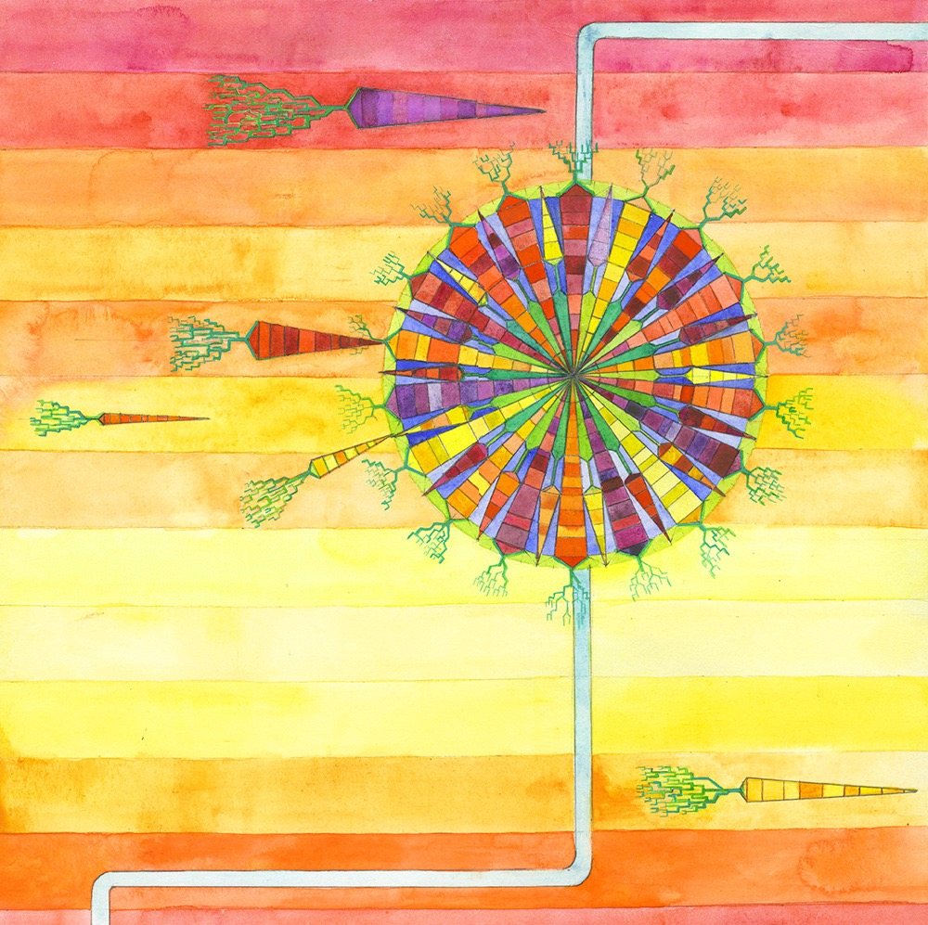
Outreach and Extension
CarrotOmics Database
Field Days and Workshop
Conferences and Symposia
Stakeholder Advisory Engagement
Germplasm Release and Publications

Slide 2
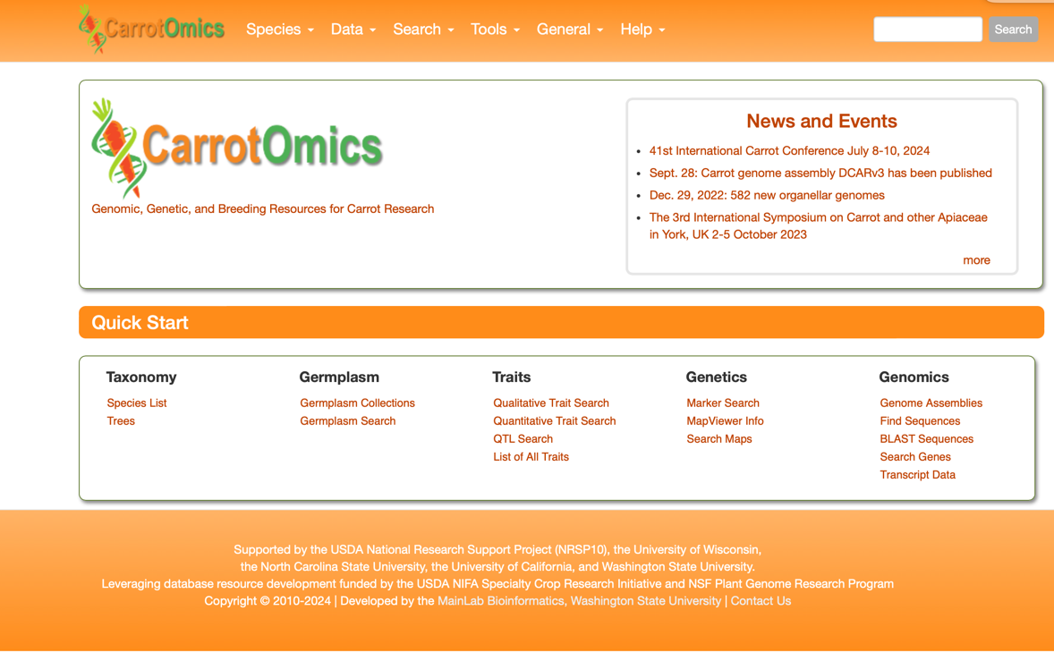
CarrotOmics

Slide 3
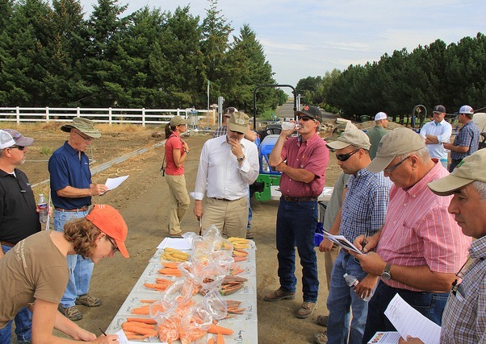
Farmer/ Industry Field Days
Western Washington – Organic Seed Alliance Organic Trials, Historical Trials
WSU – Nematode Trials (Tim Waters) and Cavity Spot Trials (Lindsey Dutoit)
UCDavis – Field days and student engagement
UCCE Kern – Alternaria, Nematode, Red Trial, Historical Trial (Jasprit Sidhu)
UW Madison / USDA ARS – Large scale screening trials, GRIN and Breeding Lines
Purdue – on-farm trials (Lori Hoagland)
UC Desert Research Station – Winter Nursery and Farm Smart Program (Jairo Diaz)

Slide 4
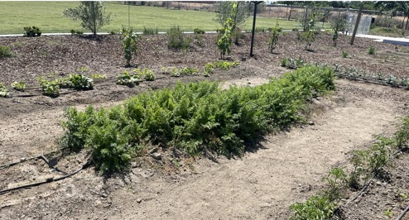
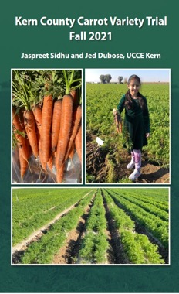
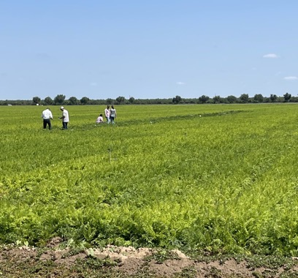
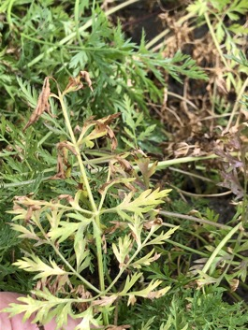
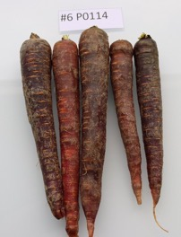
Research and Extension- UCCE Kern
Organic colored trial: 12 lines in 2023
Domestication trial
Field days every Spring and Fall for the local carrot Industry and breeders
School gardening project (Elementary School) educating on carrot production and colored carrots and nutrition
Newsletters on the field trials
Alternaria Screening: 30 lines screened for resistance in 2022, 2023
Cavity Spot: 55 lines screened in 2023 trial

Slide 5
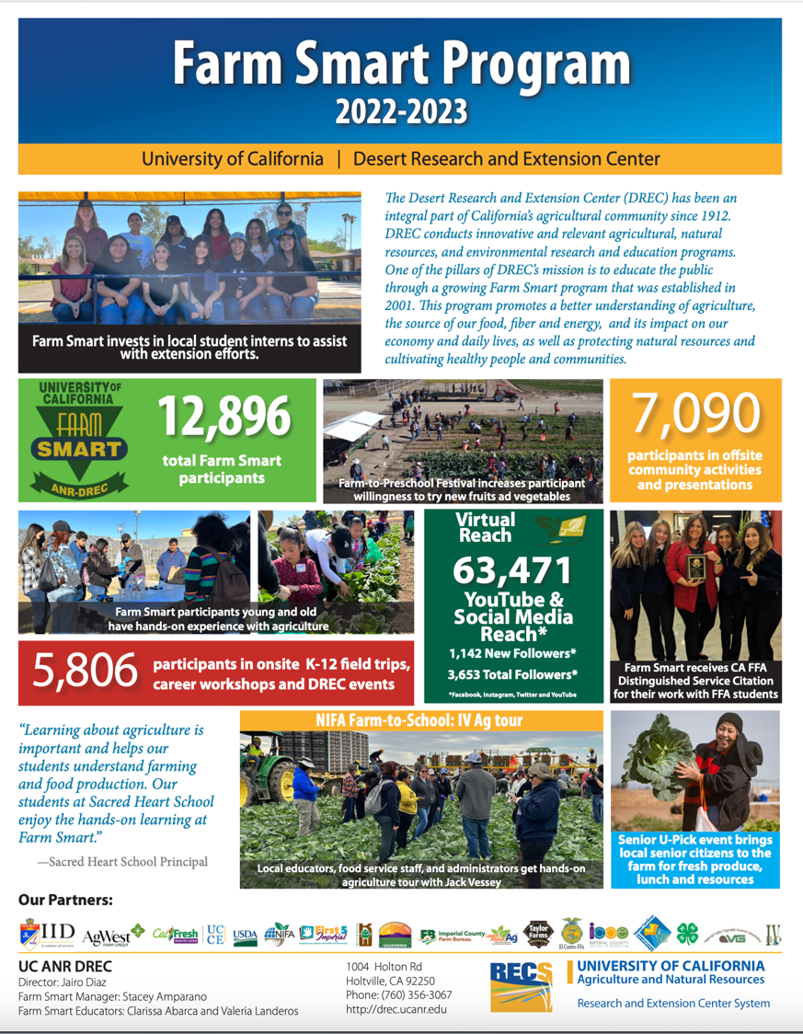
UC Research and Extension
(Jairo Diaz and team)
Farm to School Education
Career Workshops
Public Outreach
Demonstration Garden
Eat more vegetables campaign!

Slide 6
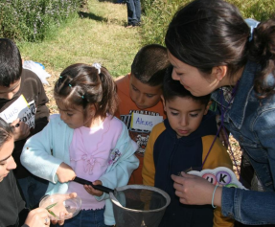
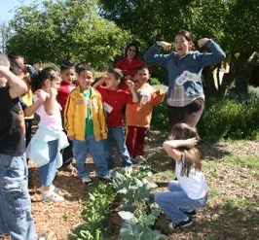

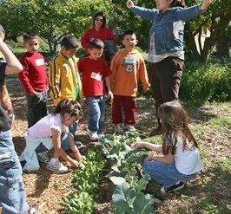
UC Davis Outreach
Farm & garden field days at the Student Farm for nearly 1,900 elementary school students, Kindergarten to 6th grade (ages 5-12).
Students learn the science of trial evaluation, selection and tasting.
Garden ”taco” – kids eating vegetables and talk about how each color acts like a superhero to give their bodies special powers.

Slide 7
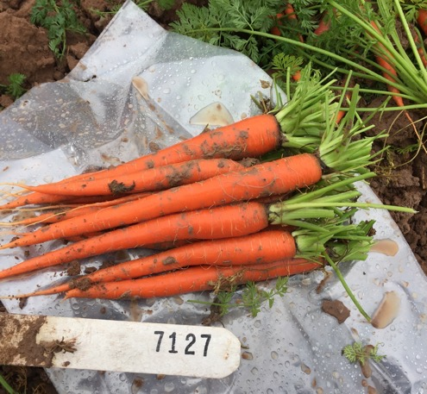
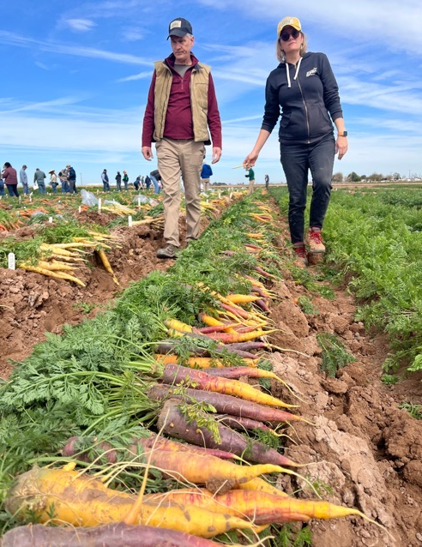
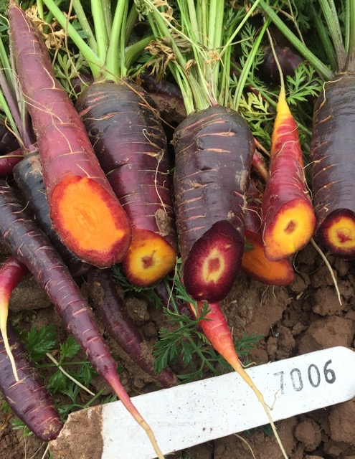
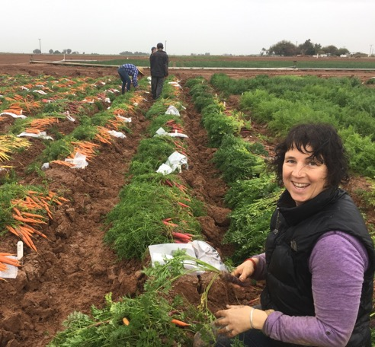
El Centro Winter Nursery
Industry Trial – call for seed Sept/Oct, field day March
Winter breeding nursery screening and selection
Grin Growout (2022-2023)

Slide 8
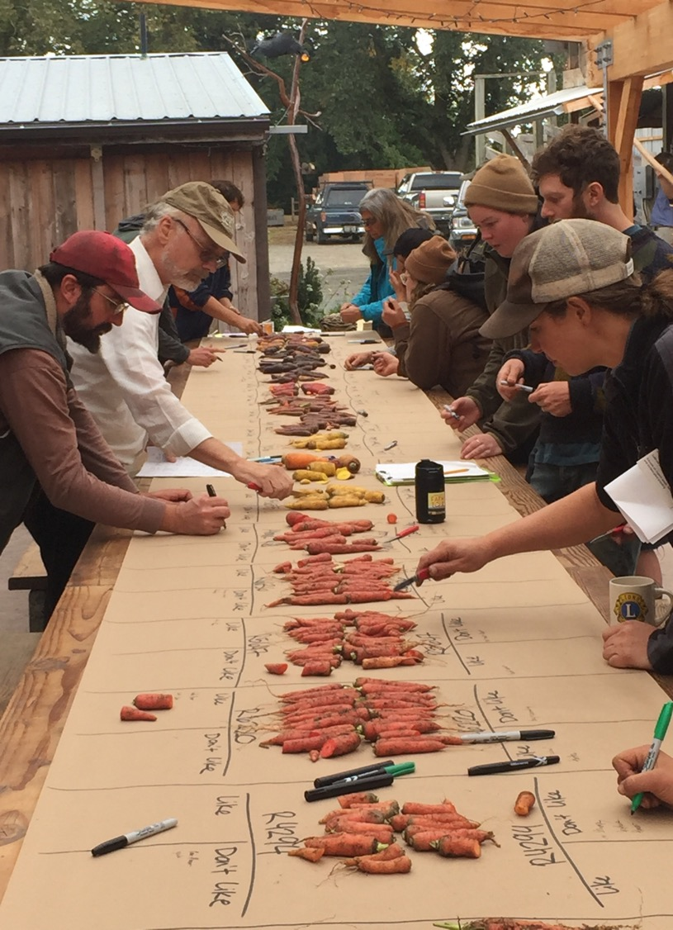
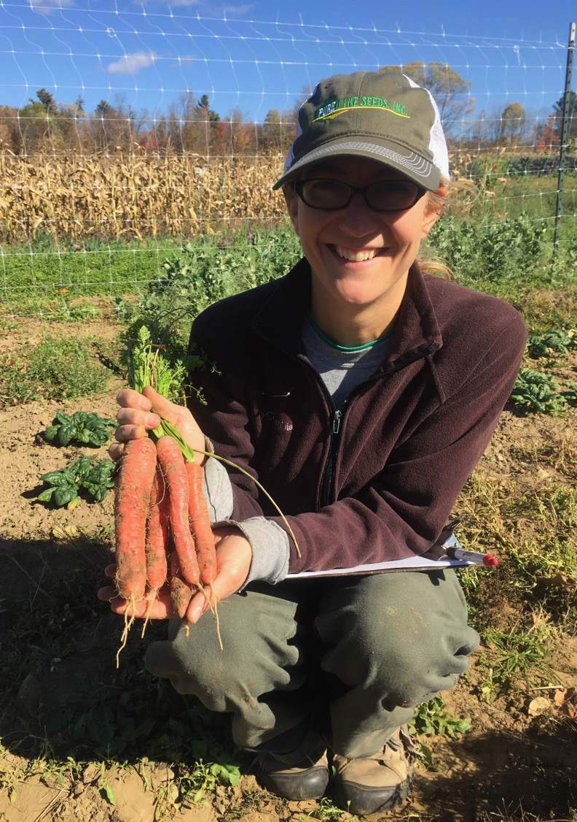
Organic Seed Alliance
Organic Industry Outreach/Promotion
Variety Release Collaboration
Organic Trials - Farmer Field Days (Research farm W. WA)
Culinary Breeding Network Variety Showcase

Slide 9

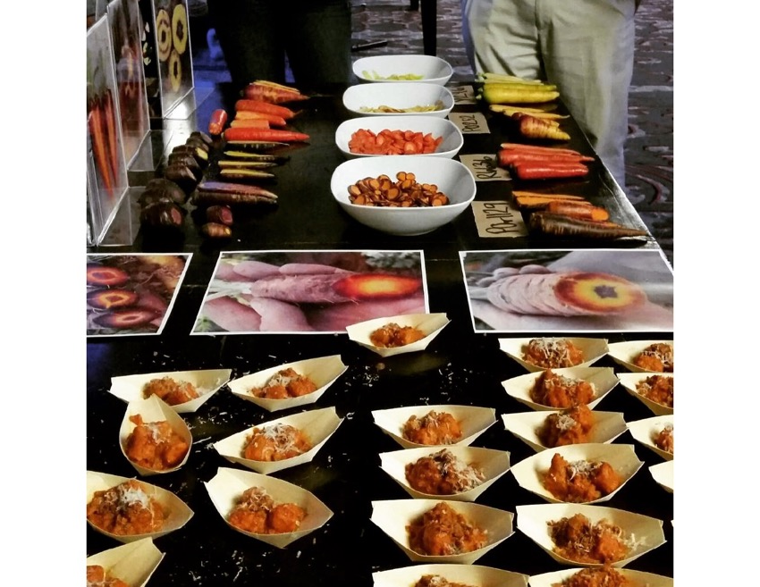
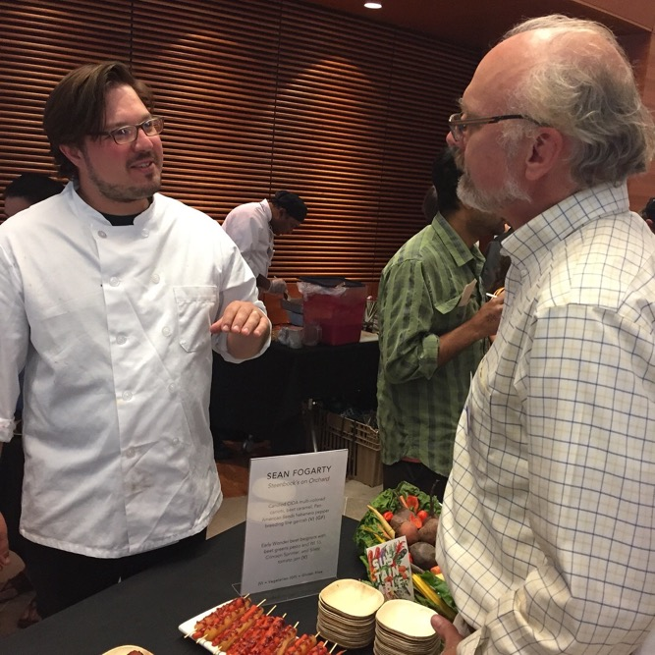
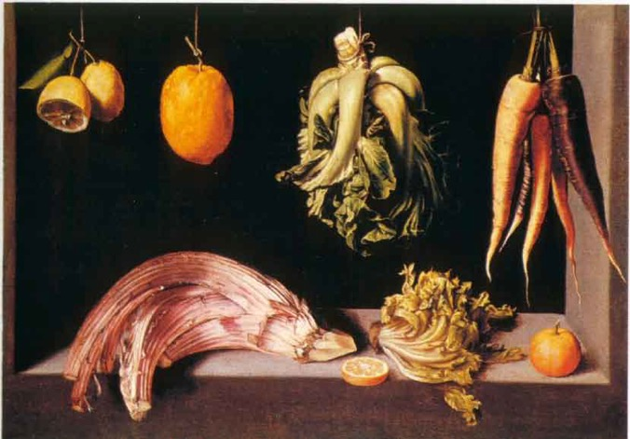
Culinary Breeding Network & Seed To Kitchen Collaborative
Variety Showcases
September 8th - Portland, Oregon

