Slide 1
The Economic Effects and Potential Payoff to Research to improve flavor, nutrition, and production traits in carrots
Prepared for the project advisory panel meeting,
Raleigh, N.C. July 8, 2024
Hanbin Lee, Robin Goldstein, Olena Sambucci, and Daniel A. Sumner
Agricultural and Resource Economics, University of California, Davis

Slide 2
The Demand Side:
Willingness to Pay for Carrot Attributes, before, and after the COVID-19 Pandemic
July 8, 2024
Hanbin Lee, Robin Goldstein, and Daniel A. Sumner
Agricultural and Resource Economics,
University of California, Davis

Slide 3
Research Questions
Distribution of willingness to pay (WTP) for the organic attribute and the baby-cut attribute?
How did COVID-19 affect the WTP for the organic attribute and the baby-cut attribute?
Use these surveys as the basis for a new set of intensive surveys of potential consumer responses to more specific attributes
Evaluations in the retail stores and UC Davis sensory lab as we have done for other foods and consumer products.

Slide 4
Empirical Strategy
Data:
A large online survey from almost 400,000 respondents, broadly representative of US carrot buyers by age, gender, and region. One simple question, with demographics supplied by Google. Repeated identical surveys before the pandemic (December 2019 & January 2020), during the peak pandemic (several rounds from March 2020 through March 2021), and after the pandemic (October 2022).

Slide 5
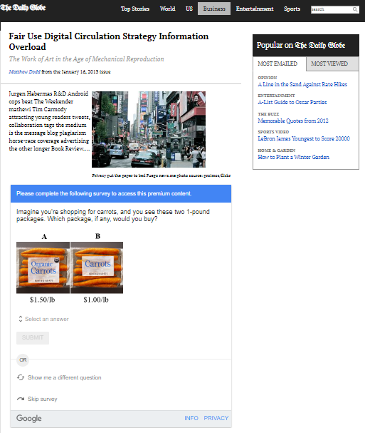
How Each Respondent Answers a Survey: Step 1
When landing on a website, a visitor faces a request to take survey that acts as a barrier for access to the content.
Google asks ‘want to take this survey’

Slide 6
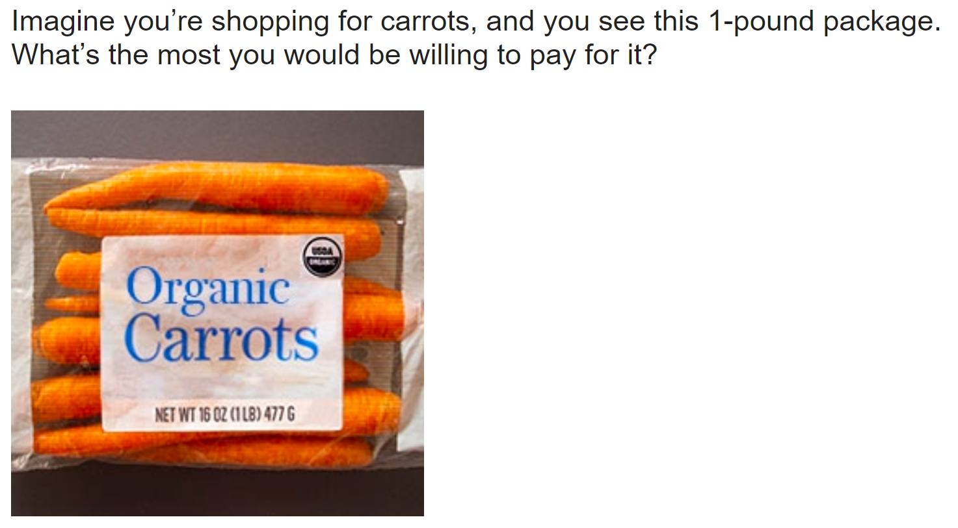
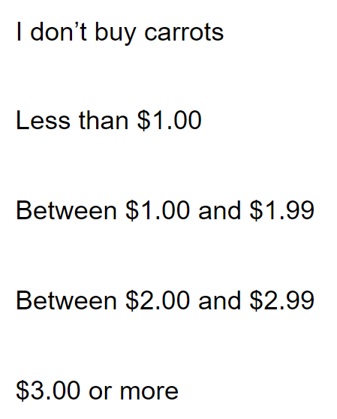
Example Multiple Choice Question: Organic Full-sized

Slide 7
Empirical Strategy
Data for our main willingness to pay parameter estimation
(our main set of questions used for our econometrics:
  Two identical products except for one attribute, consumers pick one with differing relative prices to reveal the willingness to pay for the attribute. The discrete choice model specification allows the identification of WTP parameters

Slide 8
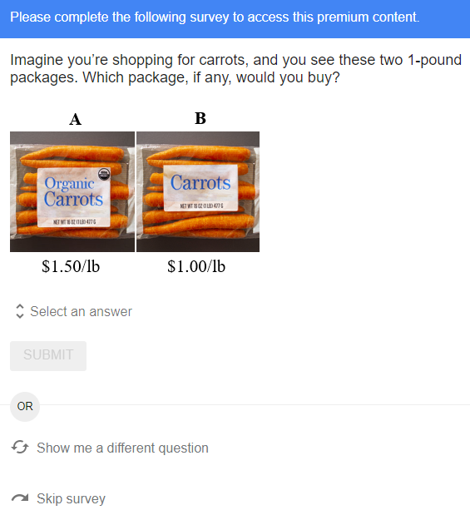
How Each Respondent Answers a Survey: Step 2
The visitor has several options:
(1) Answer the offered one-question survey
(2) Ask for a different survey
(3) Skip the survey

Slide 9
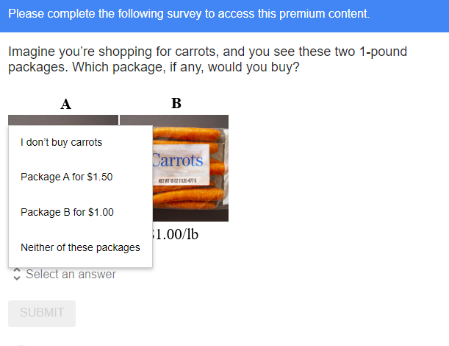
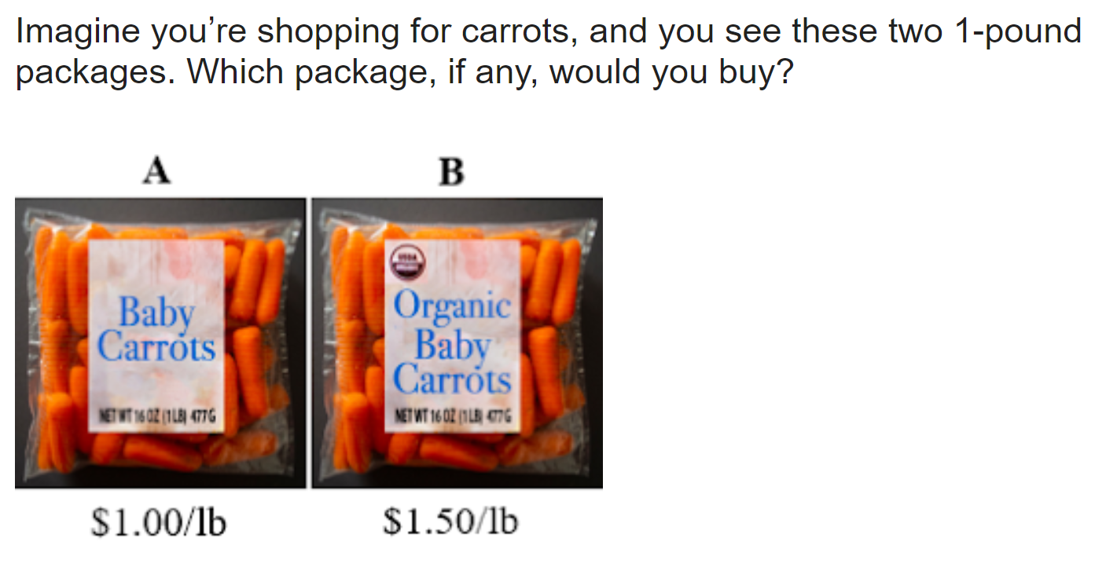
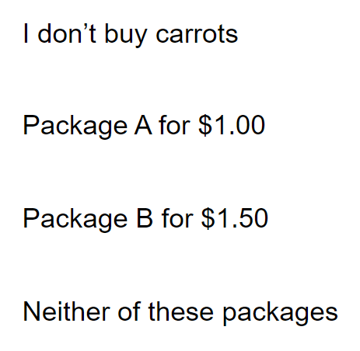
Yes-No Question: Organic Attribute for Baby-Cut Carrots
Step 3: If the visitor decides to answer the survey, read the question and select an answer among several options.

Slide 10
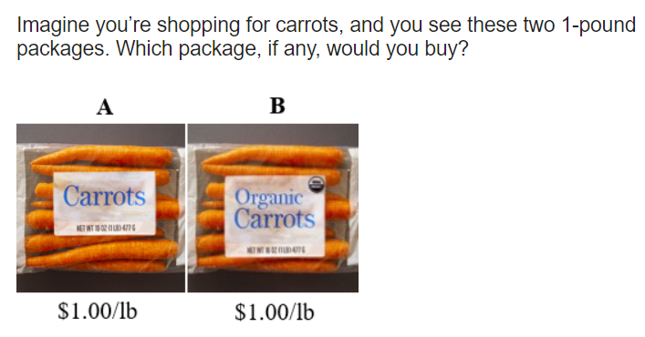
Which would you choose?
A, B or neither?

Slide 11
Our preliminary
result:
37% A vs. 63% B

Slide 12
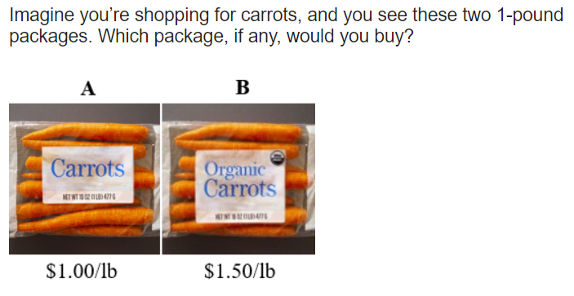
71% A vs. 29% B

Slide 13
Preliminary response shares by price difference, comparing non-organic full-sized versus organic full-sized (not baby carrots)
Price difference
$1.00/lb.
23%
$0.50/lb.
29%
$0.00/lb.
63%
20%
40%
60%
80%
Share of choosing organic, (after excluding “I don’t buy carrots” and “neither”)

Slide 14
Preliminary Average Willingness to Pay for Organic & Fresh Cut Attributes
Period | Organic attribute |  | Fresh-cut attribute
 | Full size | Fresh cut | Non-Organic | Organic
 | $/lb.
Midwest | $0.02 | $0.03 | $0.74 | $0.74
West | $0.28 | $0.35 | $0.45 | $0.61
Average | $0.14 | $0.17 | $0.67 | $0.71
25 – 34 | $0.18 | $0.25 | $0.73 | $0.83
35 – 44 | $0.21 | $0.26 | $0.77 | $0.83
65+ | $0.08 | $0.10 | $0.53 | $0.48
Notes: Gender WTP for attributes are similar. The South is similar to the Midwest and the Northeast is similar to the West. The age WTP pattern follows an inverted U for both attributes.

Slide 15
Logistic Regression Results
Parameter estimates are large relative to standard errors.
Relative price negatively affects the probability of purchase.
  The probability of buying organic carrots is decreasing as the relative price of organic carrots is increasing.
  The probability of buying baby carrots is decreasing as the relative price of baby carrots is increasing.
COVID-19 matters little in the probability of purchase.
  The probability of buying organic carrots slightly rises by COVID-19.
  The probability of buying baby carrots slightly falls by COVID-19.

Slide 16
Median Willingness to Pay for Organic Attribute & Convenience Attribute
Median WTP estimates with 95% Confidence Intervals
Period | Organic attribute |  | Baby-cut attribute
 | Median WTP | C.I. | Median WTP | C.I.
 | $/lb.
Dec 2019 – Jan 2020 | $0.04 | ($0.02, $0.08) | $0.56 | ($0.47, $0.65)
March 2020 | $0.07 | ($0.04, $0.10) | $0.52 | ($0.43, $0.62)
June 2020 | $0.08 | ($0.05, $0.11) | $0.51 | ($0.42, $0.60)
August 2020 | $0.07 | ($0.05, $0.10) | $0.53 | ($0.44, $0.62)
October 2020 | $0.07 | ($0.04, $0.10) | $0.50 | ($0.41, $0.59)
January 2021 | $0.04 | ($0.01, $0.07) | $0.47 | ($0.38, $0.57)
Note. The margins of error are constructed based on a bootstrapping technique, with 1,000 draws.

Slide 18
Demand for Attributes relative to alternative price =$1.00

Slide 19
Current and Future Work
  Demand side 1: Use intensive surveys to query consumer WTP for specific research-based attributes and how that differs across consumers.
  Demand side 2: Use UCD sensory lab with smaller samples to probe WTP for taste and similar attributes.
  Demand side 3: Use scanner data where available to assess market demands for attributes of carrots relative to other food items.

Slide 20
The Supply Side:
Marginal Cost of Production for Carrots, with emphasis on pest management and genetic innovation
Prepared for the project advisory panel meeting,
Raleigh, North Carolina
July 8, 2024
Olena Sambucci and Daniel A. Sumner.
Agricultural and Resource Economics,
University of California, Davis

Slide 21
Approaches and Relevant Issues on the Cost Side of Carrot Economics
Summarize the U.S. carrot industry and its economic roles in the rural economy in production regions and for consumers.
  Trends in state and regional acreage, volume, prices, and trade
  Trends in production practices and disease management
  Economic losses to major diseases
Characterize the evolving varieties in terms of their potential economic contributions
Develop sample cost of production data on carrot production to document payoffs from improved varieties.
Develop aggregate measures of regional and nationwide payoffs to improved varieties based on projections about adoption rates and timing

Slide 22
Pesticide Use Reports (PURs) and Cost and Return Studies
Pesticide Use Reports document all applications of restricted pesticides in California since 1994
Date of application, product, active ingredient, acres treated, dose per acre, crop and planted acreage
These data have been used regularly by economists and other, including Dr. Sambucci for a series of studies about varietal and practice innovations for grapes among other crops.
Costs of chemical products and application costs are collected from the Cost and Return Studies underway at UC Davis.
The cost of product studies have other independent value to the project.

Slide 23
Application to Improved Varieties in Carrots
Major disease of carrots: nematodes, cavity spots, Alternaria leaf blight
Nematodes is the worst in terms of costs to control and loss of crop
All three diseases use pesticide products as a part of UC IPM Guidelines
Products used are included in Pesticide Use Report Data
Begin with trends and costs of pesticides used on organic and conventional carrots
Recent work in progress: Fusarium Basal Rot management in onions and garlic

Slide 24
More contributions of PURS data if it accurately captures practices
Identification of the use of organic materials will confirm organic field and practices separately
Pesticide uses can be used to indicate concerns for nematodes, cavity spots, Alternaria leaf blight
If the PURS data are accurate for fields and locations, we can correlate material use by location and therefore project payoff locally to new varieties

Slide 25
California Carrot Acreage and Carrot Acres Treated
 | 2012 | 2012 | 2017 | 2017 | 2022 | 2021
County | Census acres | Pesticide use acres | Census acres | Pesticide use acres | Census acres | Pesticide use acres
Kern | 33,414 | 217,999 | 30,328 | 216,548 | 20,571 | 151,287
Imperial | 14,871 | 95,529 | 13,819 | 154,890 | 19,733 | 97,095
Others | 17,115 | 186,034 | 18,530 | 183,172 | 20,704 | 189,298
CA Total | 65,400 | 499,562 | 62,677 | 554,610 | 61,008 | 437,680

Slide 26
Implied pesticide applications per acre
 | 2012 | 2017 | 2021/22
County | Pesticide/Census Acres Ratio | Pesticide/Census Acres Ratio | Pesticide/Census Acres Ratio
Kern | 6.52 | 7.14 | 7.35*
Imperial | 6.42 | 11.21 | 4.92*
Others | 10.87 | 9.89 | 9.14*
CA Total | 7.64 | 8.85 | 7.17*
*Note that Pesticide data is for 2021 and the Census acreage is for 2022.

Slide 27
More work is needed to Confirm that the PURS data accurately captures practices
The full data on materials used and times used per field will help account for uses by crop.
County and location variation of materials will be correlated across neighbors
Do county aggregates indicate reasonable patterns of material use.
Can PURS data be used to measure crops per year by field and in aggregate for counties?
Is the census data accurate enough to use of a base of total acres used for carrots by county?
Is County Ag. Department data an accurate base to compare to Census and between Census years?

Slide 28
THANK YOU
Questions on the Economics? dasumner@ucdavis.edu

