Slide 1
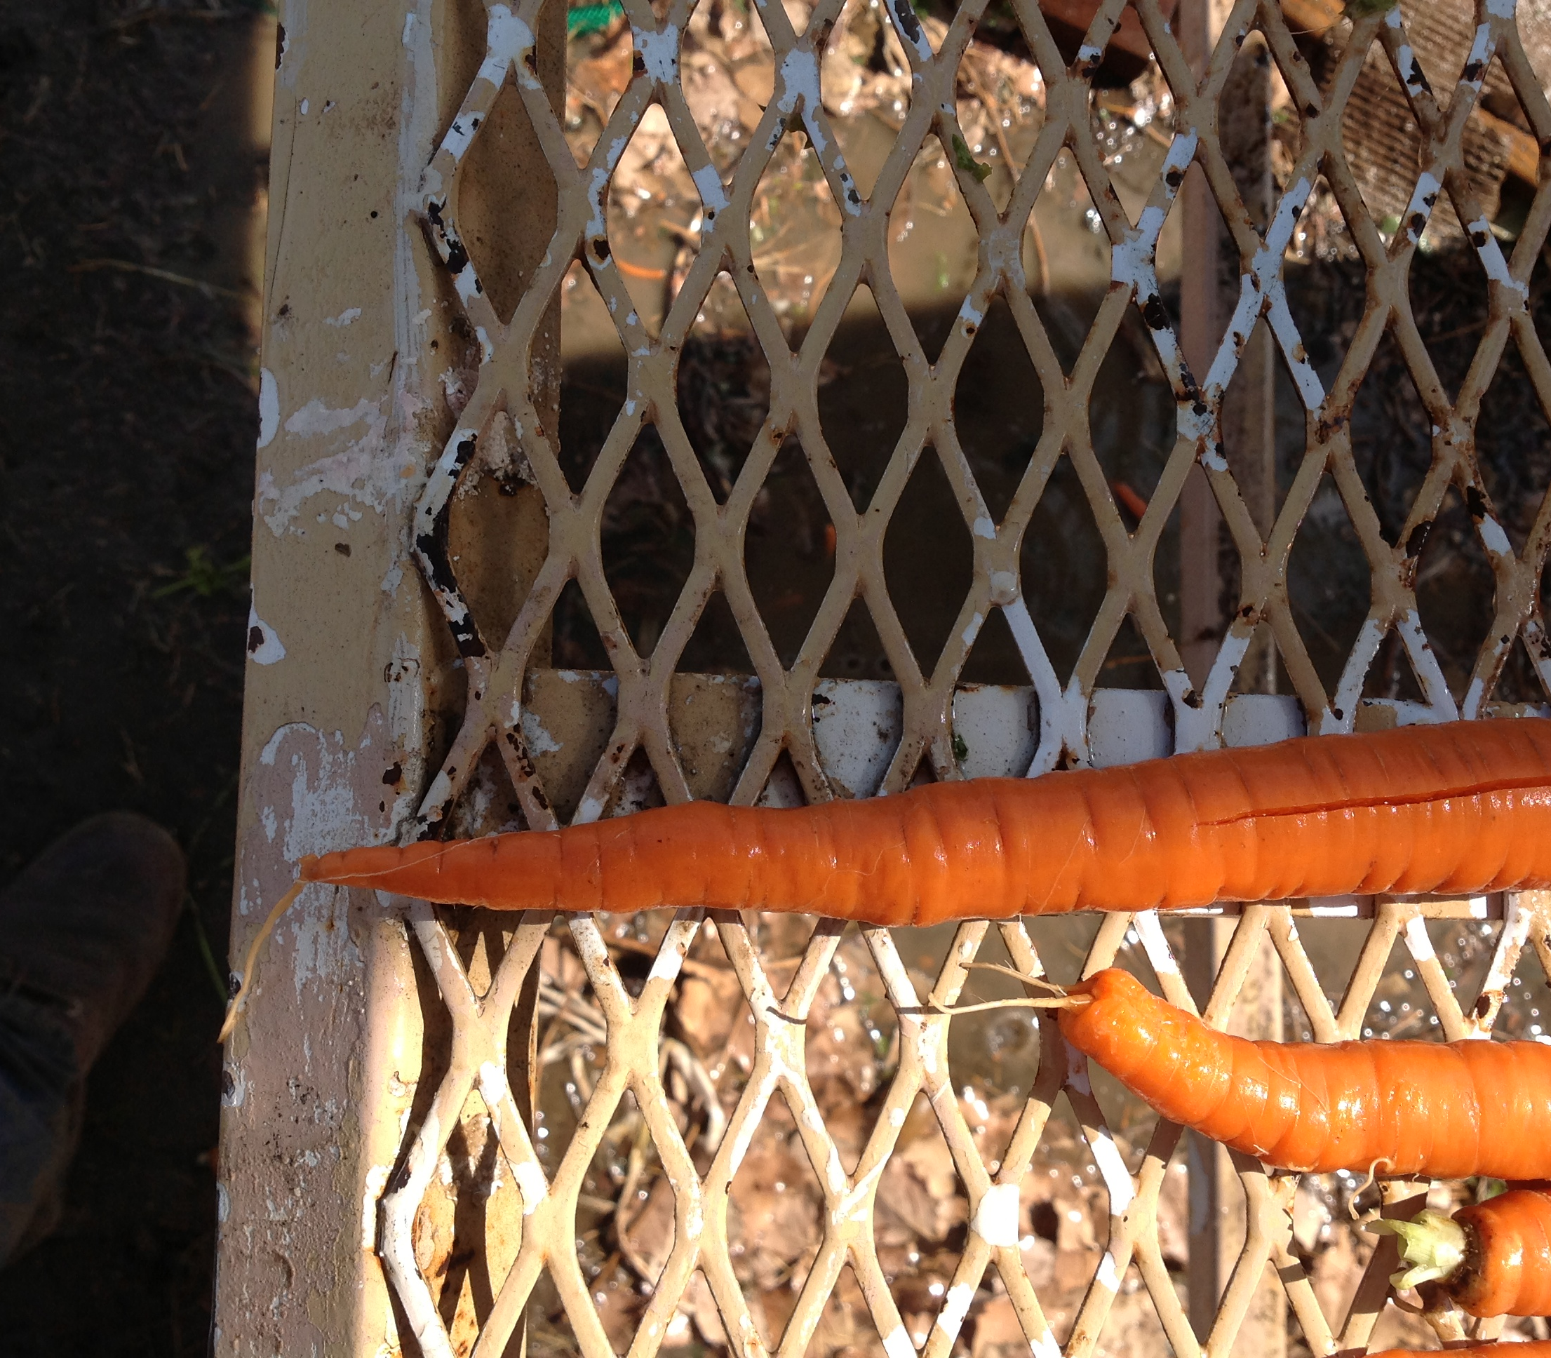
Extension Efforts Washington State 2023
Field Trial/Demonstration in Grower Field-40 lines, 3 Replicates
Presentation on Carrot Research Activities-Pacific Northwest Vegetable Association Annual Meeting- L. du Toit
Informal Grower Discussions in Field

