Slide 1
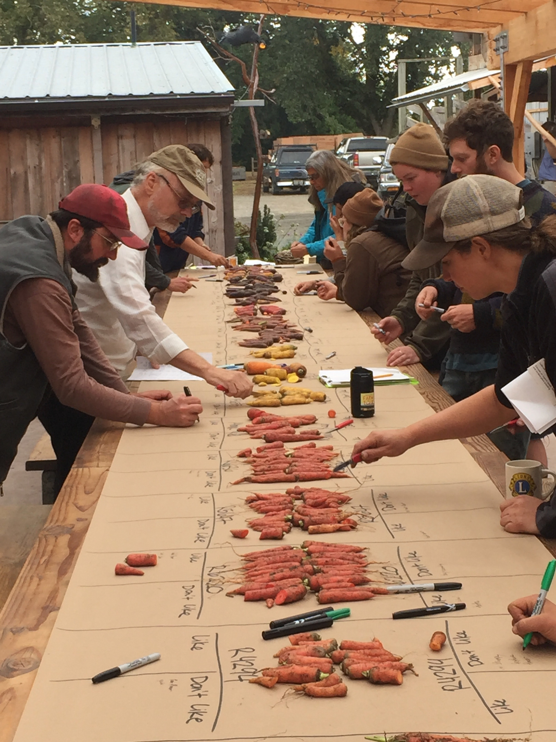
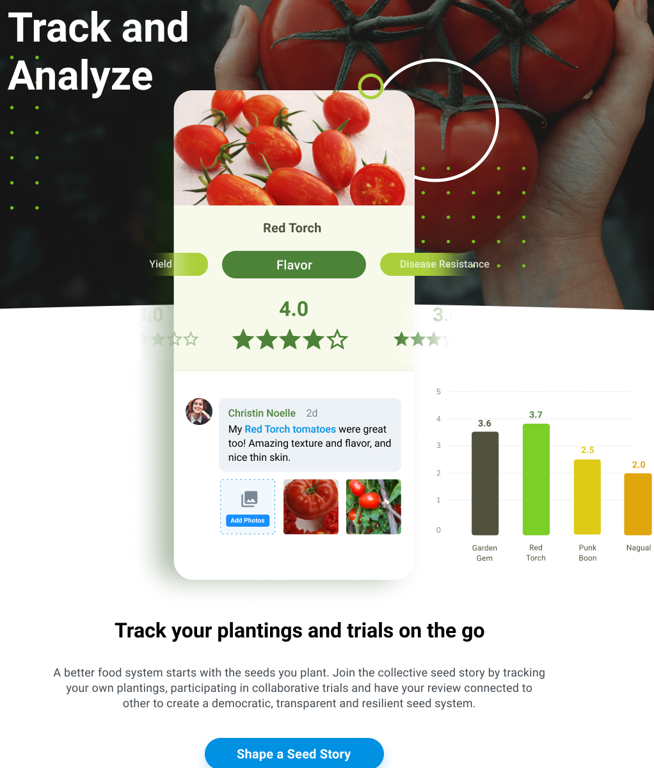
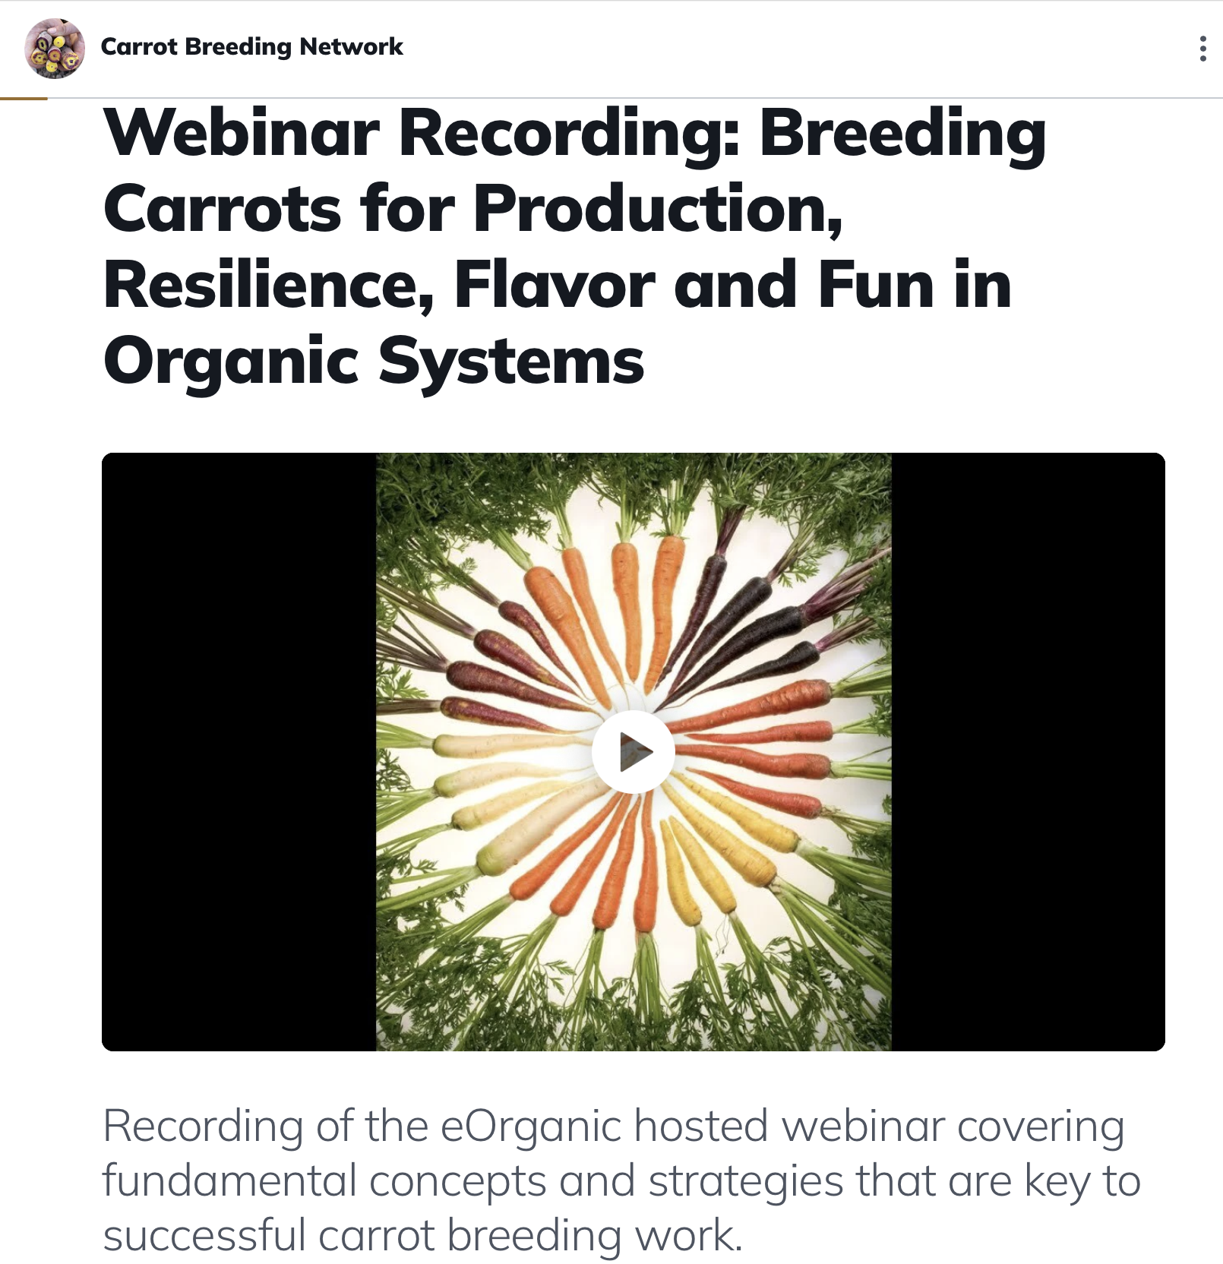
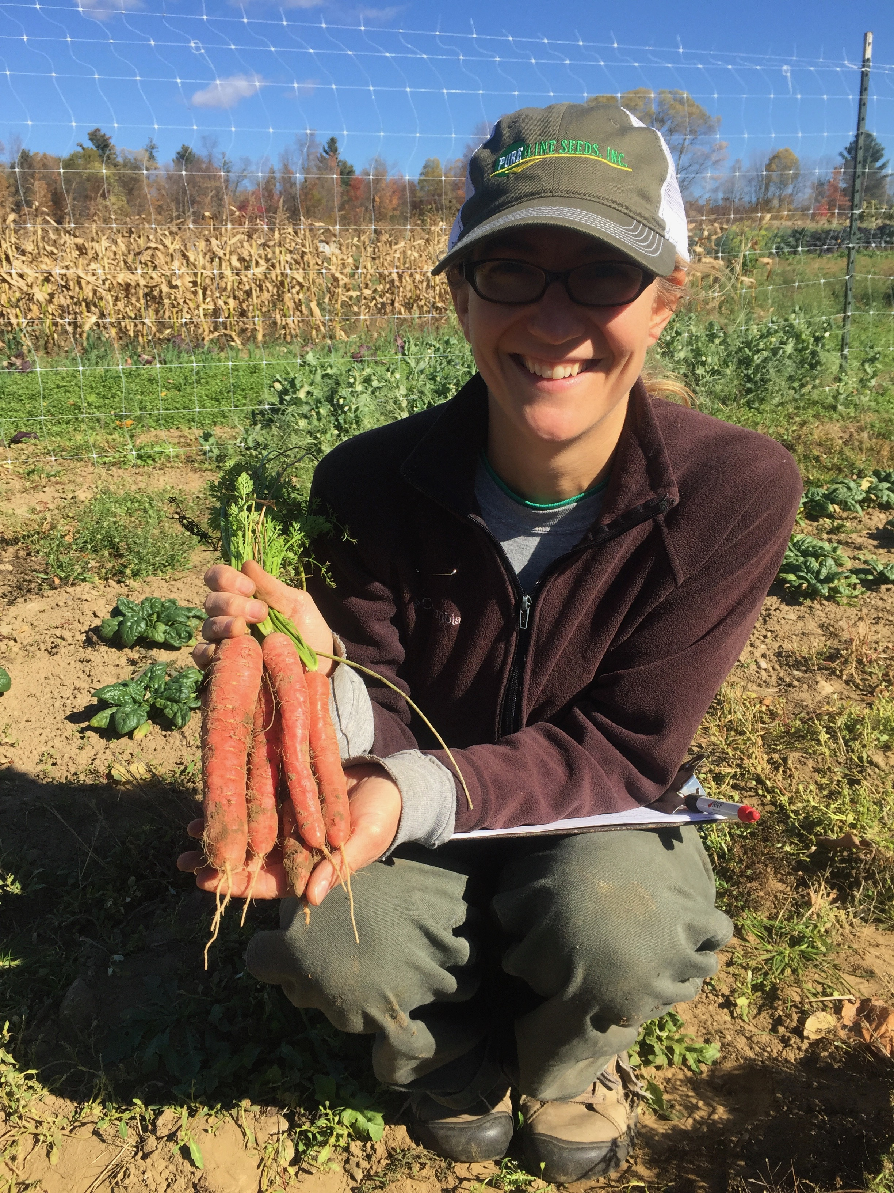
Outreach - Organic Producers and Seed Companies
Online Networking and Educational Webinars via Organic Seed Commons
Organic Seed Company Trials
Decentralized On-farm Trials, coordinated through SeedLinked
On-farm Field Days

