Slide 1
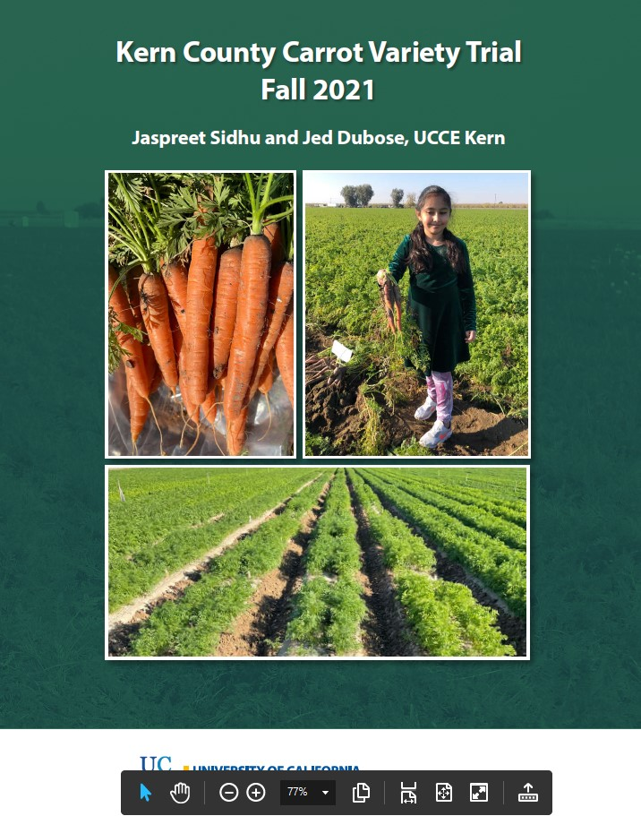
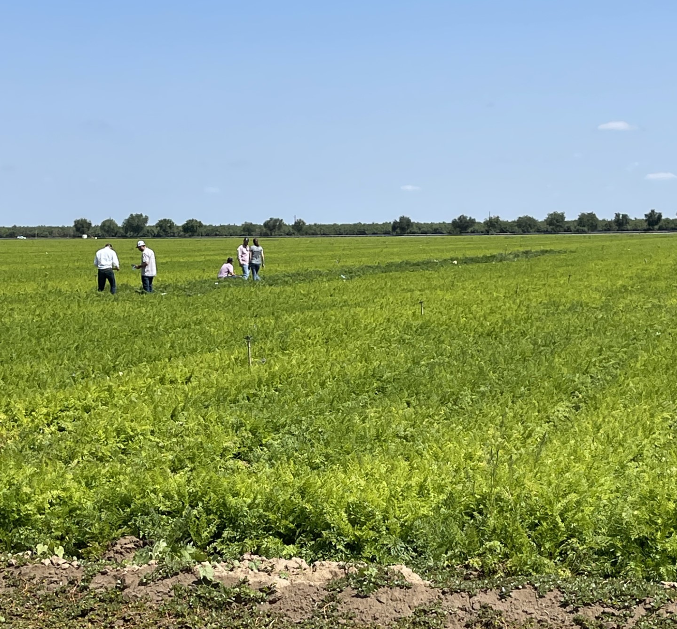
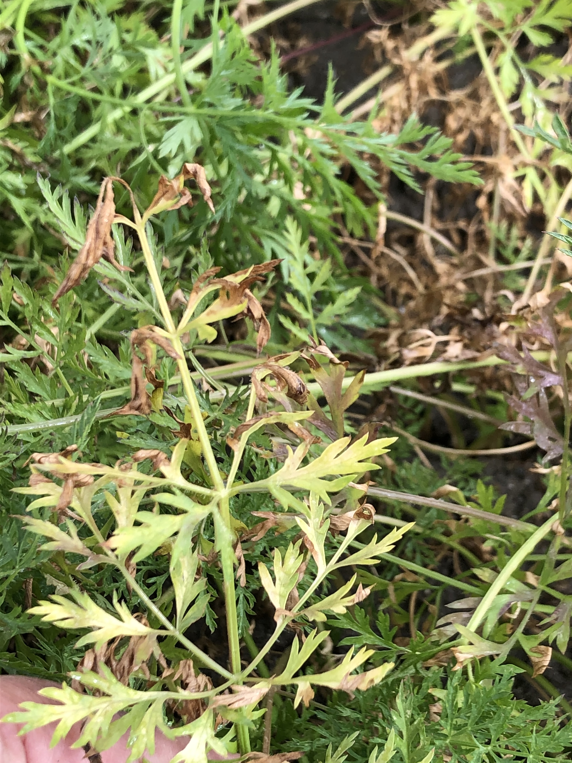
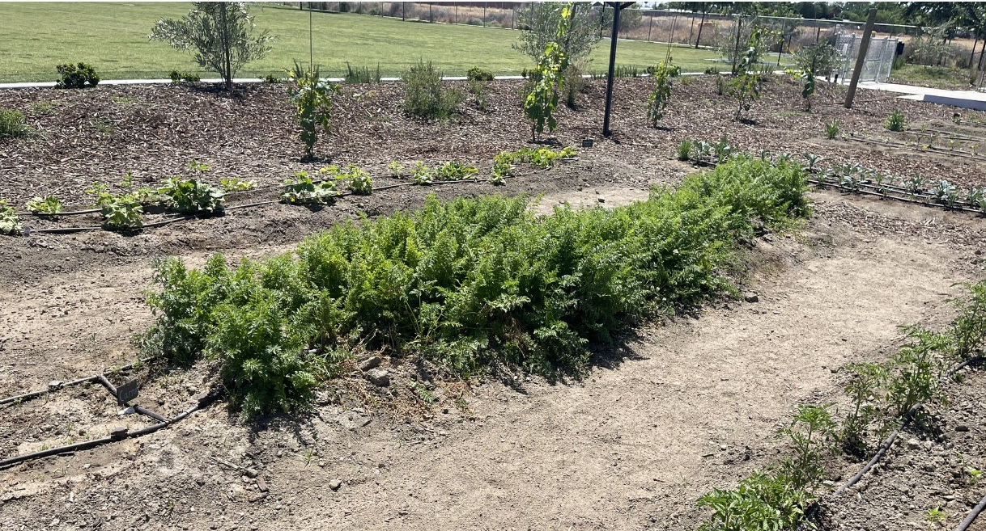
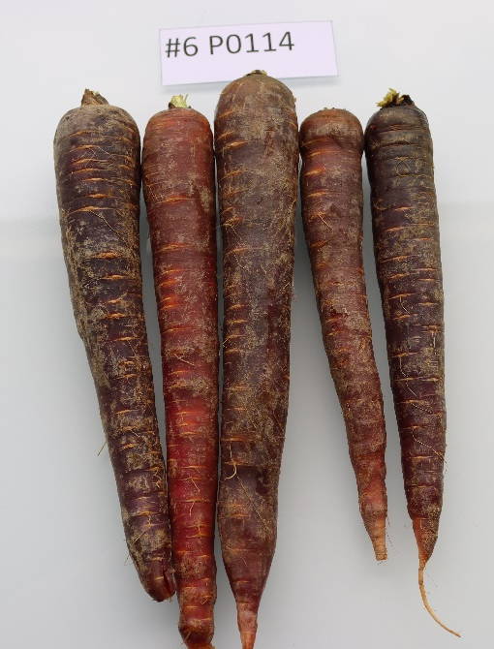
Research and Extension- UCCE Kern
Organic colored trial: 35 lines in 2022
Field days every Spring and Fall for the local carrot Industry and breeders
School gardening project (Elementary School) educating on carrot production and colored carrots and nutrition
Newsletters on the field trials
Alternaria Screening: 30 lines screened for resistance in 2022, 2023
Cavity Spot: 55 lines screened in 2023 trial

