Slide 1
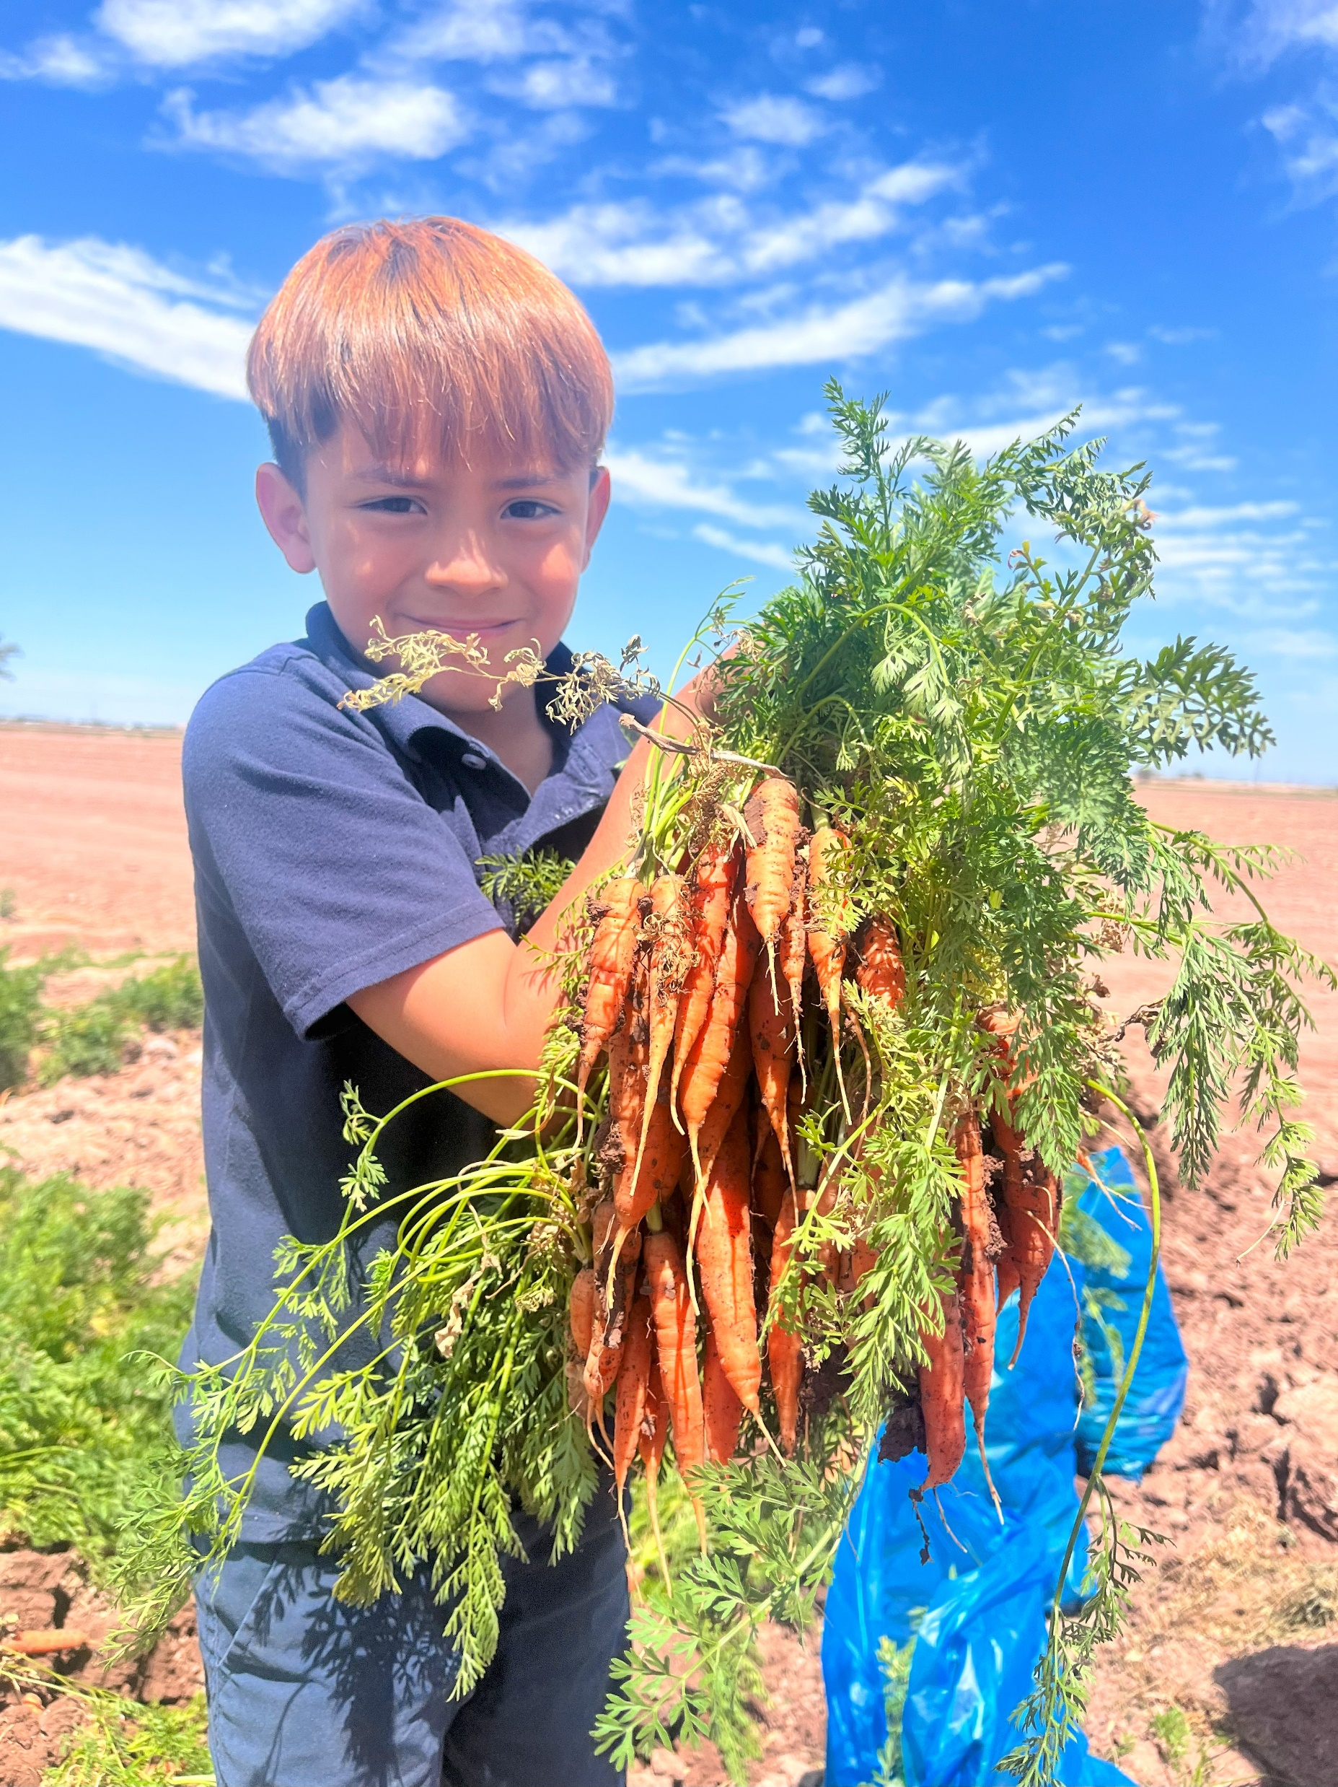
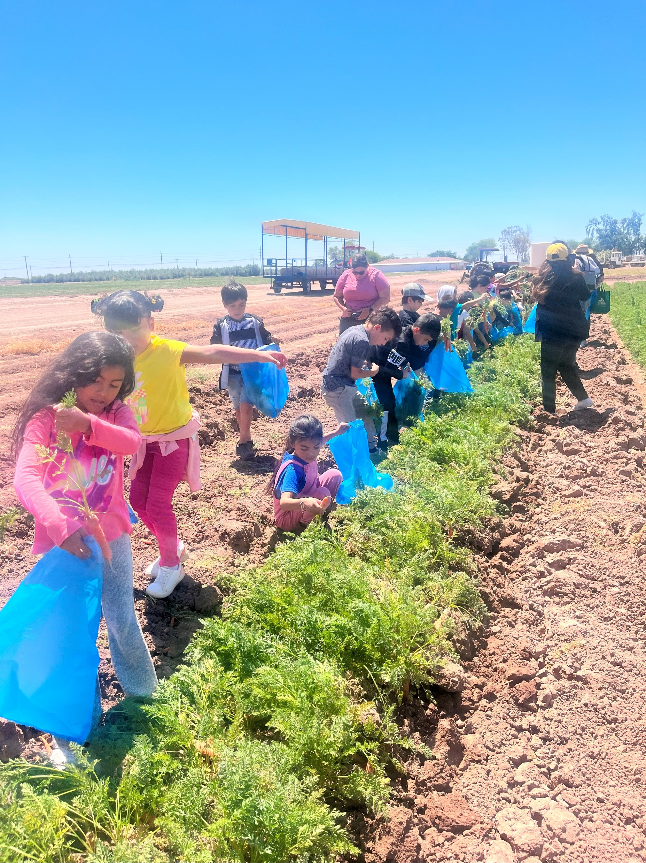
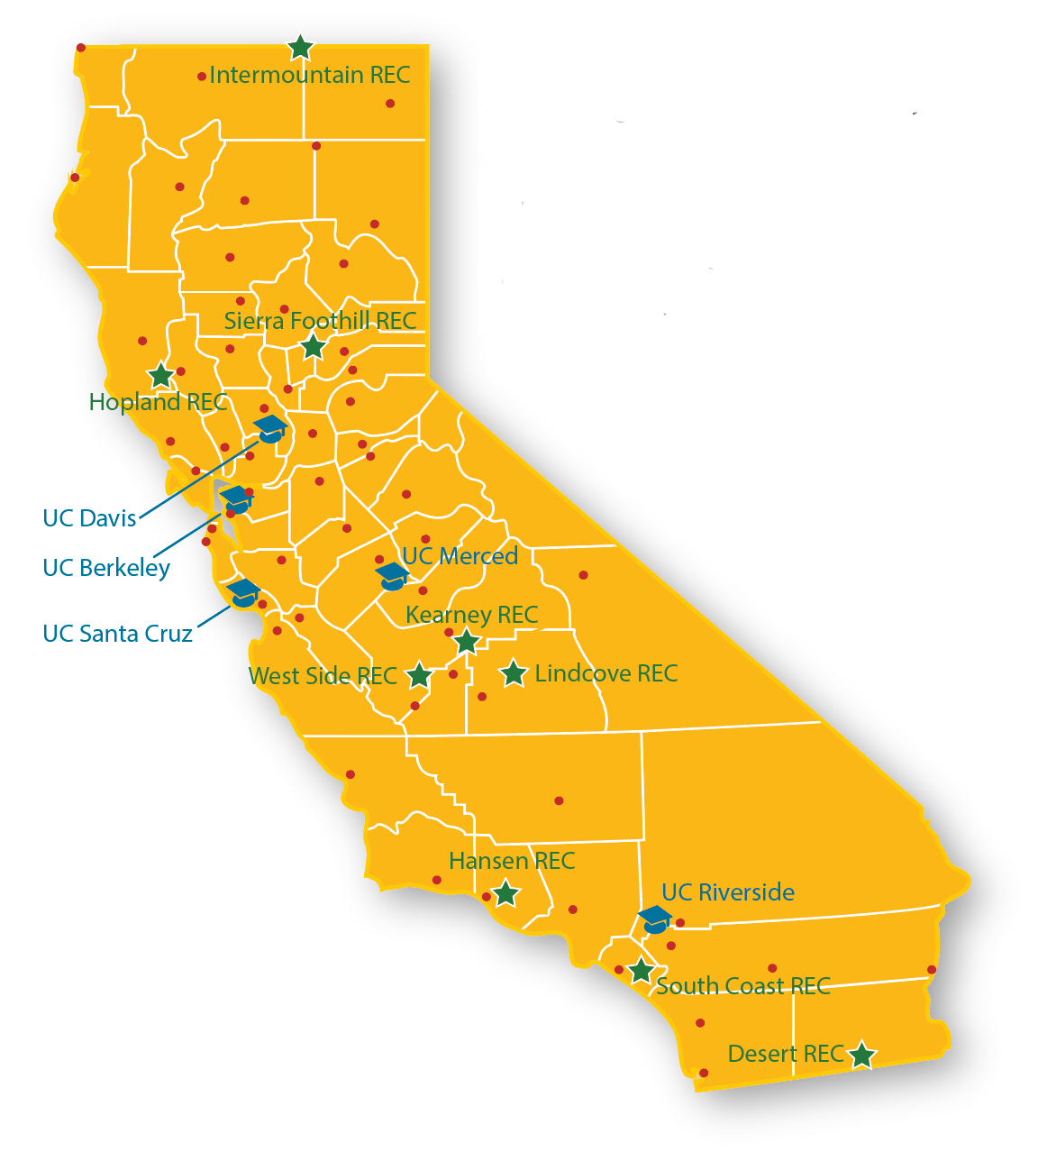
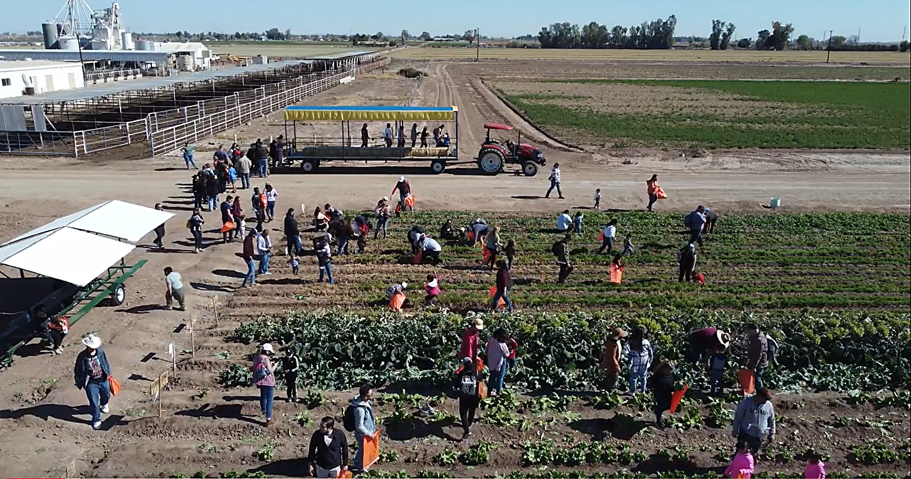


Carrot Outreach at Desert REC
Summary:
From 2022 to 2023 Farm Smart delivered carrot outreach programs in nutrition and production to 2908 participants, which includes educators, K-12 students, and community members.
Farm to Summer Interactive Summer Program (45)
Farm Tours (463)
Farm-to-Preschool Festival (1116)
Vegetable Adventures Field Trips (992)
Community Events/ U-pick (292)
Project Team:
Dr. Jairo Diaz
Dr. Yu Meng
Stacey Amparano
Clarissa Abarca
Valeria Landeros
Fatima Gutierrez- Intern
University of California Desert Research and Extension Center

