Slide 1
Demand for Carrot Attributes, before, and after the COVID-19 Pandemic
Prepared for USDA project advisory panel
December 13, 2023
Hanbin Lee, Robin Goldstein, and Daniel A. Sumner
Agricultural and Resource Economics,
University of California, Davis

Slide 2
Research Questions
Distribution of willingness to pay for the organic attribute and the baby-cut attribute?
How COVID-19 affected the WTP for the organic attribute and the baby-cut attribute?

Slide 3
Empirical Strategy
Data:
A large online survey from about 360,000 respondents, broadly representative of US carrot buyers by age, gender, and region. One simple question, with demographics supplied by Google. Repeated identical surveys before, during, and after COVID-19.
Parameter estimation:
  Two identical products except for one attribute, consumers pick one with differing relative prices to reveal the willingness to pay for the attribute. The discrete choice model specification allows the identification of WTP parameters

Slide 4
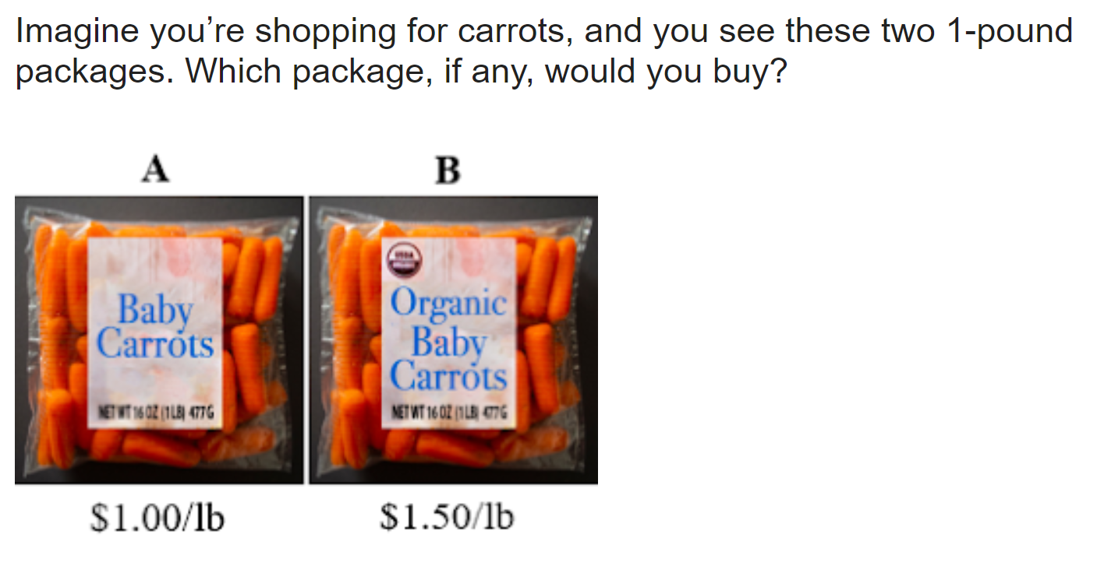
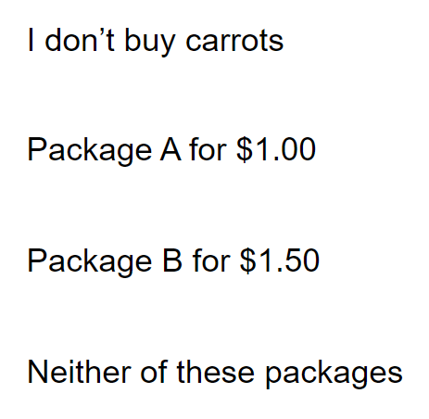
Yes-No Question: Organic Attribute for Baby-Cut Carrots

Slide 5
Average Willingness to Pay for Organic & Fresh Cut Attributes
Period | Organic attribute |  | Fresh-cut attribute
 | Full size | Fresh cut | Non-Organic | Organic
 | $/lb.
Midwest | $0.02 | $0.03 | $0.74 | $0.74
West | $0.28 | $0.35 | $0.45 | $0.61
Average | $0.14 | $0.17 | $0.67 | $0.71
25 – 34 | $0.18 | $0.25 | $0.73 | $0.83
35 – 44 | $0.21 | $0.26 | $0.77 | $0.83
65+ | $0.08 | $0.10 | $0.53 | $0.48
Notes: Gender WTP for attributes are similar. The South is similar to the Midwest and the Northeast is similar to the West. The age WTP pattern follows an inverted U for both attributes.

Slide 7
Demand for Attributes relative to alternative price =$1.00

Slide 8
Current and Future Work
  Demand side 1: Use intensive surveys to query consumer WTP for specific research-based attributes and how that differs across consumers.
  Demand side 2: Use UCD sensory lab with smaller samples to probe WTP for taste and similar attributes.
  Demand side 3: Use scanner data where available to assess market demands for attributes of carrots relative to other food items.
  Supply side: California pesticide use data supplies detailed farm data to observe patterns over time.

