Slide 1
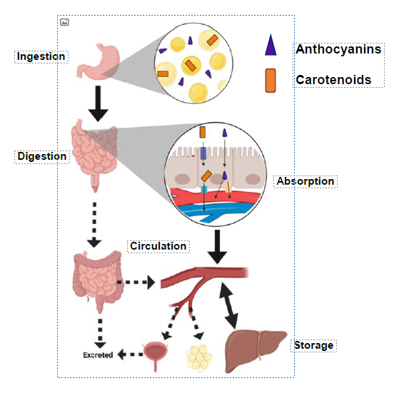
Bioavailability studied in Mongolian gerbils and humans

Slide 2
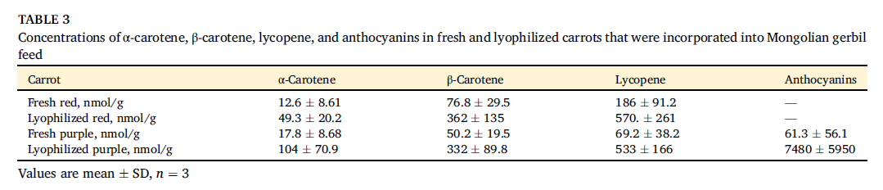
Concentrations in carrots
Kaeppler et al., J Nutrition, 2023

Slide 3
Lycopene dose response from red carrot in gerbils

Slide 4
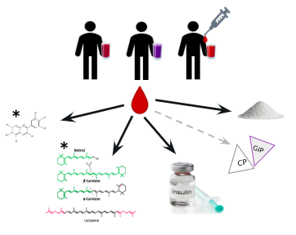
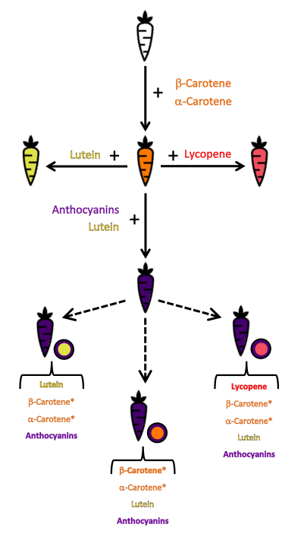
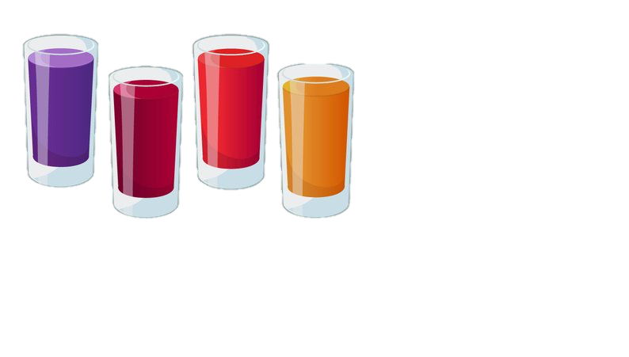
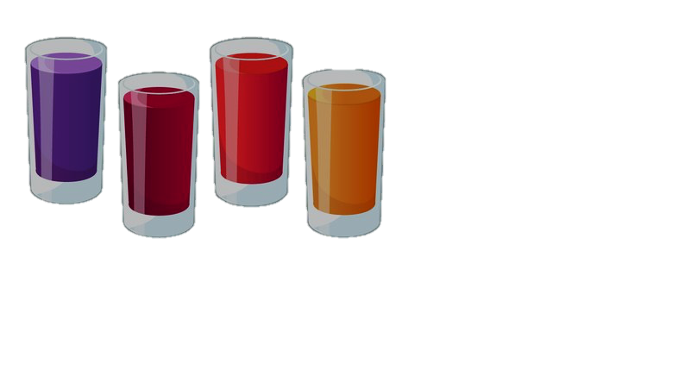

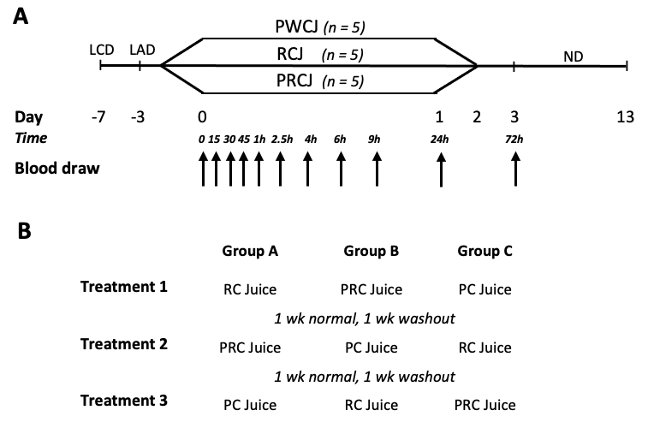
Purple Carrot Juice Study- Design
4)
4)
4)
Glu, Ins, C-Pep, GIP
Antho, Carot
Antho, Carot
Lunch
Notes:
The study duration for each subject was 53 days, which included 3 11-day arms consisting of a week long washout period and 4 treatment days. During the treatment period, participants came to CRU first day (Trt day), 2nd and 4th day
Blood was taken at base (0), drank juice ate bread then draws taken…. After treatment
The participants were allowed to return to their normal diet and activities following the last blood draw at the end of each arm. All part rotated between juice type at each arm.

