Slide 1
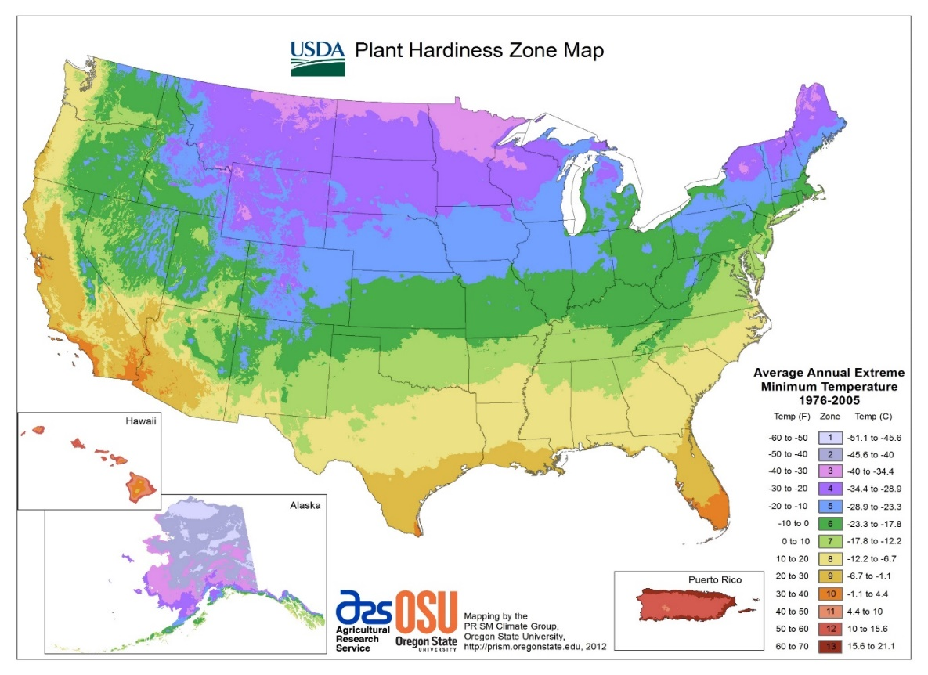
Bolting in Carrot Plant Introductions
Experimental design and Locations:
Complete block with 2 locations with 2 replications per location.
The trial consisted of 695 accessions including 675 PIs.
Scored the fraction of plants bolting in each plot.
Hancock, WI
Riverside
Coachella Valley
El Centro

Slide 2
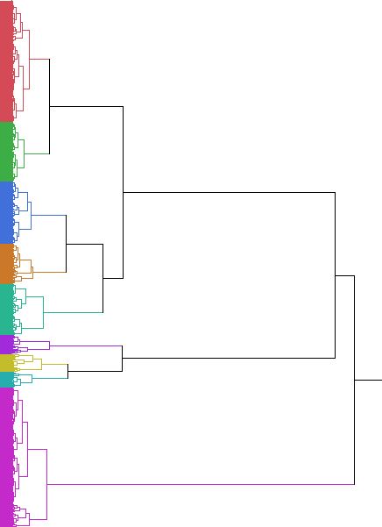
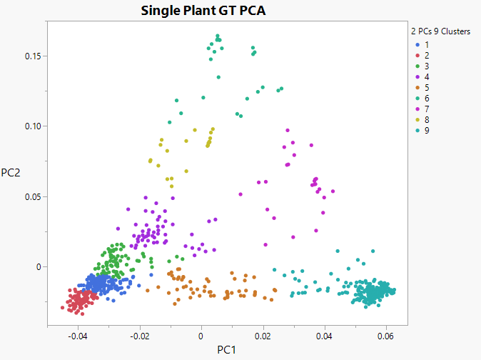
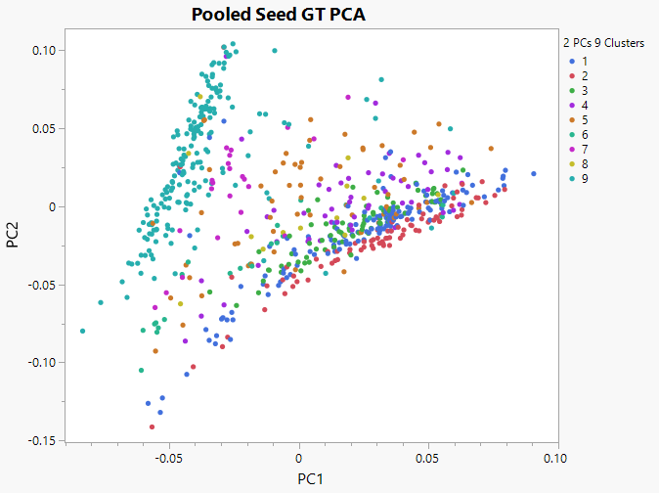
PCAs on based on pooled genotypes (GBS) don’t separate as well as and single plant (reseq)
East
West
1 2 3 4 5 6 7 8 9
East
West
East
West

Slide 3
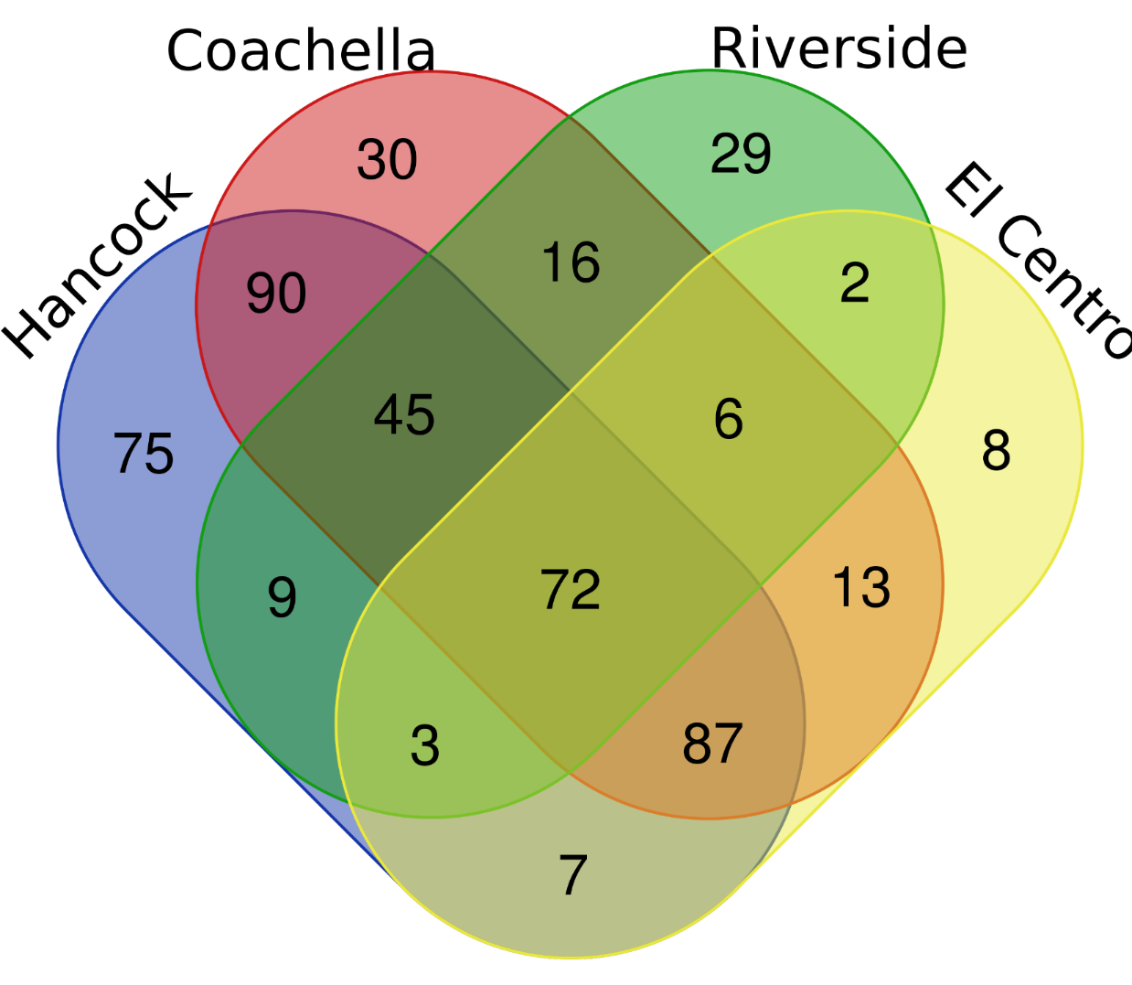
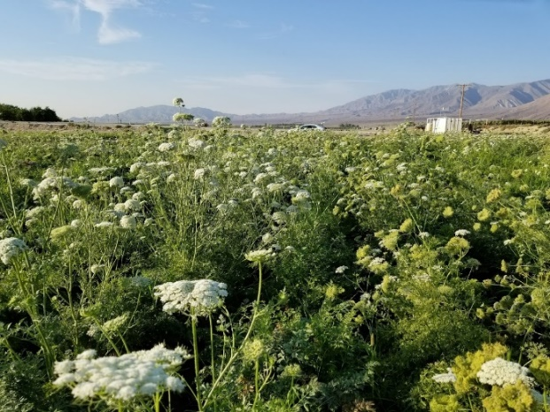
Number of Carrot lines bolting across 4 locations
Rapid cycling lines?

Slide 4
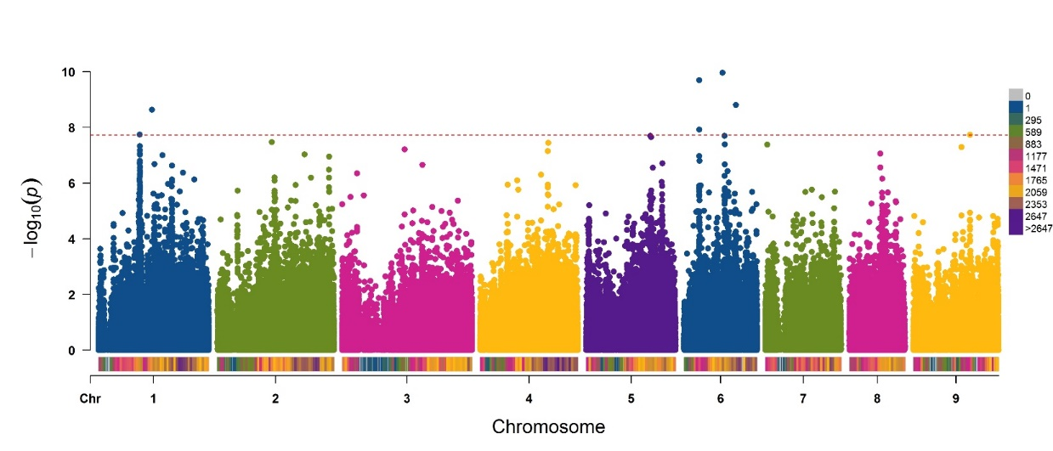
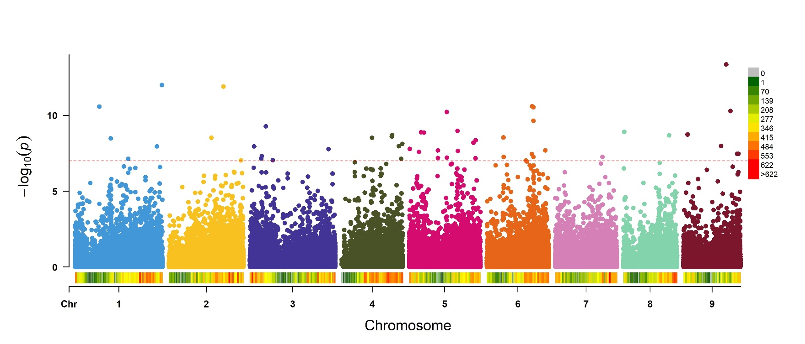
Hancock 2017 bolting progress area
Gene that regulates flowering time in Arabidopsis via a pathway that is independent of day length (the autonomous pathway).
Single plant
Pooled seed

Slide 5
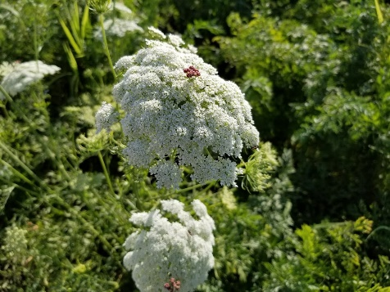
Conclusions
183 of 675 lines did not bolt in any locations
Summer environments, 14-15hr/daylength, are highly correlated
There is large Genotype x Environment interactions
GWAS detected significant loci in each environment and is sensitive to technology/sampling
Candidate genes can be identified and should be verified
Bolting is a complex trait in carrot

Slide 6
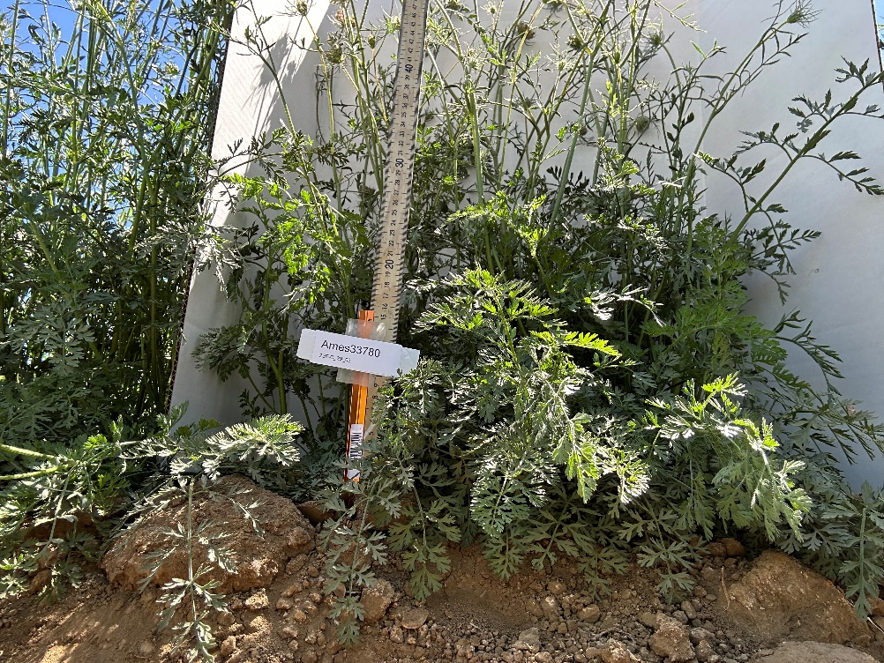
Bolting Resistance in landraces
SCRI I
183 of 675 lines did not bolt in any of 5 locations
Summer environments, 14-15hr/daylength, are highly correlated
There is large Genotype x Environment interactions
GWAS detected significant loci in each environment and is sensitive to technology/sampling
Candidate genes can be identified and should be verified
Bolting is a complex trait in carrot
SCRI II
Selected 10 non and 10 bolting lines
F2 populations currently growing
Will map genes in biparental populations
Test genomic selection models
K-12 outreach- 1760 K-5, 30 Undergrads

