Slide 1
Drought Tolerance
Phil Simon & Harun Ar Rashid
USDA-ARS/Univ. Wisconsin & Bangladesh Agricultural University

Slide 2
Impact of drought on carrot production
Irrigation water availability is increasingly more limited and expensive in major carrot production areas
Drought consequences
  Reduced plant growth
  Reduced quality
  Reduce profitability

Slide 3
Drought Tolerance
Carrot SCRI 2016-2021
700 PIs evaluated by Phil Roberts in field & greenhouse
A subset of 199 PIs evaluated in the greenhouse by Harun Ar Rashid & Phil Simon
  Wilting severity and recovery after 12 days without water for all entries
  Chlorophyll & flavonoid content, gas exchange for stomatal conductance, photosynthesis and water use efficiency evaluated in a subset of 4 tolerant and 4 intolerant
  Transcriptome analysis in a subset of 4 tolerant and 4 intolerant
  Root weight, pigment content evaluated at harvest for all entries

Slide 4
At 70 DAS
Stop watering
0 Days after drought treatment
4 tolerant + 4 susceptible accession (3 replication)
0 Days with irrigation
4T + 4S (3 replication)
3 Days after drought treatment
4 tolerant + 4 susceptible accession (3 replication)
3 Days with irrigation
4T + 4S (3 replication)
6 Days after drought treatment
4 tolerant + 4 susceptible accession (3 replication)
6 Days with irrigation
4T + 4S (3 replication)
9 Days after drought treatment
4 tolerant + 4 susceptible accession (3 replication)
9 Days with irrigation
4T + 4S (3 replication)
Re-watering starts
12 Days after drought treatment
4 tolerant + 4 susceptible accession (3 replication)
12 Days with irrigation
4T + 4S (3 replication)
18 Days after drought treatment
4 tolerant + 4 susceptible accession (3 replication)
18 Days with irrigation
4T + 4S (3 replication)
24 Days after drought treatment
4 tolerant + 4 susceptible accession (3 replication)
Upto 30 DAT
24 Days with irrigation
4T + 4S (3 replication)

Slide 5
At 70 DAS
Stop watering
Leaf sampling for RNA Sequencing
0 Days after drought treatment
4 tolerant germplasm (2 replication)
4 susceptible germplasm (2 replication)
0 Days with irrigation
Sampling- 4T + 4S
(2 replication)
6 Days after drought treatment
4 tolerant germplasm (2 replication)
4 susceptible germplasm (2 replication)
6 Days with irrigation
Sampling- 4T + 4S
(2 replication)
12 Days after drought treatment
4 tolerant germplasm (2 replication)
4 susceptible germplasm (2 replication)
12 Days with irrigation
Sampling- 4T + 4S
(2 replication)

Slide 6
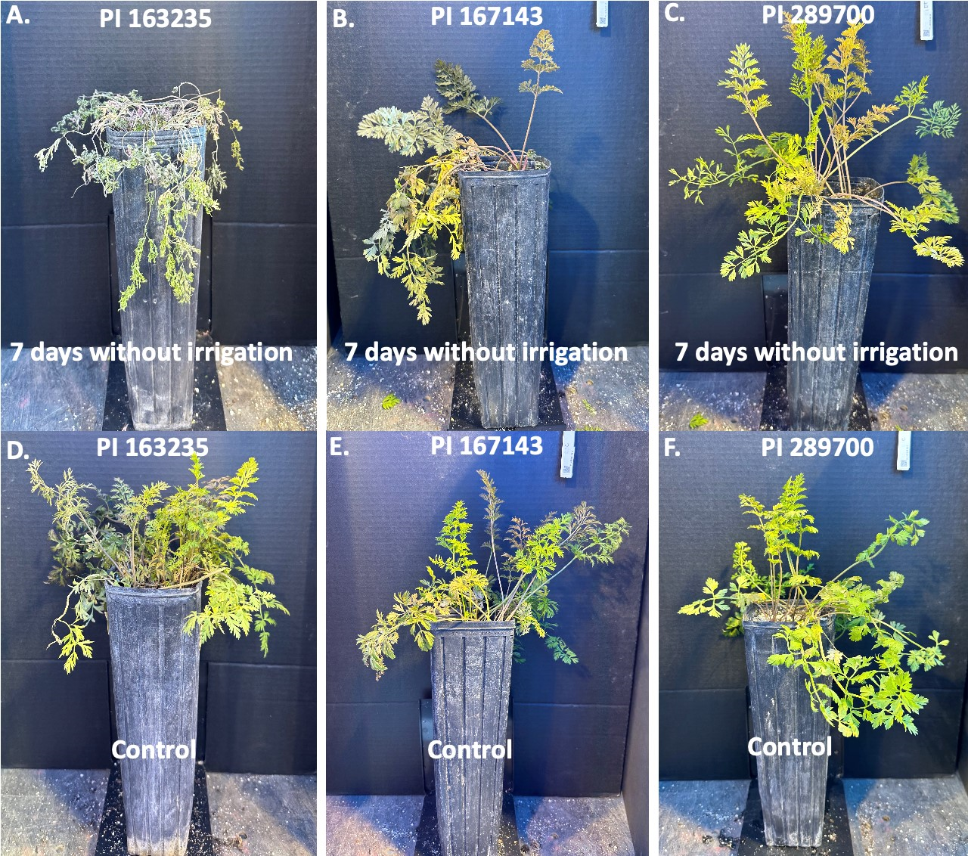
Seven days without (top row) and with (bottom row) irrigation for 3 carrot PIs

Slide 7
Year 1 – BP 1
Year 2 – BP 2
Year 3 – BP 3
ElitePI-2
ElitePI-5
ElitePI-8
Elite PI-1
Elite PI-4
Elite PI-7
x
x
x
Elite PI-3
Elite PI-6
Elite PI-9
Combine Breeding Pools over multiple years of evaluation
Evaluate
Drought tolerance
Alternaria
resistance
Flavor
Etc.
Breeding pool development and evaluation strategy

Slide 8
Drought Tolerance
Carrot SCRI 2022-2026
Association analysis of the diversity collection
Evaluate mapping populations in greenhouse
Incorporate markers into breeding platform
Advance & release drought tolerant breeding pools
Evaluate selected populations in Bangladesh field (Ar Rashid presentation, this meeting)
Compare greenhouse and field performance

Slide 9
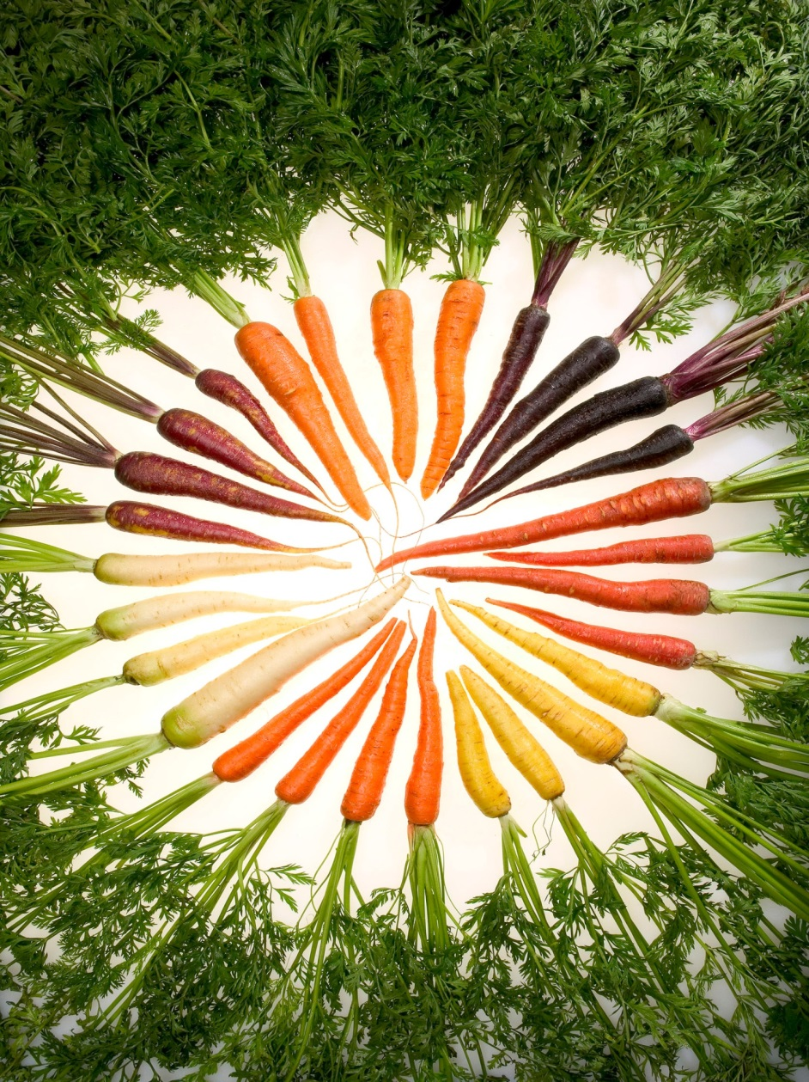
Thank you !

