Slide 1
Alternaria Leaf Blight
Phil Simon
USDA-ARS Vegetable Crops Research Unit
Department of Plant & Agroecosystem Sciences
University of Wisconsin - Madison

Slide 2
Impact of Alternaria Leaf Blight
The most devastating and economically significant foliar disease of carrots globally and in the US
In areas prone to attack, yield losses with severe infection typically range from 28-74%; 10-40 sprays (Ben-Noon et al. 2001)
  Reduced plant growth
  Weak tops reduce yield with mechanical harvest
No complete resistance, sources of partial resistance being characterized in germplasm collection

Slide 3
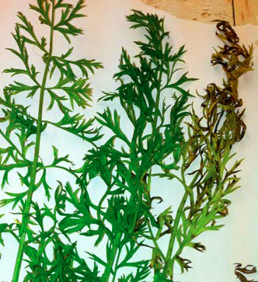
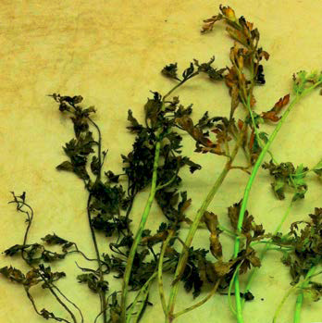
Alternaria Leaf Blight Resistance
Carrot SCRI 2016-2021
694 entries evaluated > 4 years
Disease scores ranged from 1.7– 5.0 on a 5 point scale
Few scores under 3.0
Breeding pools established
Scores of 2 (left) and 5 (right) on a 5 point scale

Slide 4
Alternaria Leaf Blight
Carrot SCRI 2016-2021
PIs and breeding lines phenotyped in Wisconsin
  Tas P, Strandberg J, and Simon PW (submitted
  Pl Path)
Create biparental mapping populations
Initiate development of breeding pools

Slide 5
The development and evaluation of carrot breeding pools & mapping populations
After evaluating PIs and inbreds, elite individuals from diverse genetic sources are used to develop breeding pools
Among selected PIs, elite plants are being intermated with plants of like-performance
  Breeding pools
A subset of phenotyped plants with contrasting phenotypes intercrossed to develop mapping populations

Slide 6
Year 1 – BP 1
Year 2 – BP 2
Year 3 – BP 3
ElitePI-2
ElitePI-5
ElitePI-8
Elite PI-1
Elite PI-4
Elite PI-7
x
x
x
Elite PI-3
Elite PI-6
Elite PI-9
Combine Breeding Pools over multiple years of evaluation
Years 4-5 evaluations
Objective 1 traits:
Alternaria
resistance
Flavor
Etc.
Breeding pool development and evaluation strategy

Slide 7
High incidence of Japanese PIs in most ALB resistant entries
Ames 22389 | NEPAL
NSL 199861 | US
NSL 34346 | US
PI 205999 | SWEDEN
PI 226043 | JAPAN
PI 226309 | JAPAN
PI 242384 | JAPAN
PI 261648 | JAPAN
PI 263019 | UK
PI 269321 | SWEDEN
PI 294090 | JAPAN
PI 502920 | GERMANY
PI 652122 | JAPAN
PI 652126 | JAPAN
PI 652128 | JAPAN
PI 652129 | JAPAN
PI 652131 | JAPAN
PI 652135 | JAPAN
PI 652136 | JAPAN

Slide 8
ALB - Carrot SCRI 2022-2026
Association analysis of diversity collection
Evaluate mapping populations
  Three populations with scores ranging from 2.8 - 5
  Incorporate markers into breeding platform
Advance & release breeding pools
Use GS to predict breeding values

Slide 9
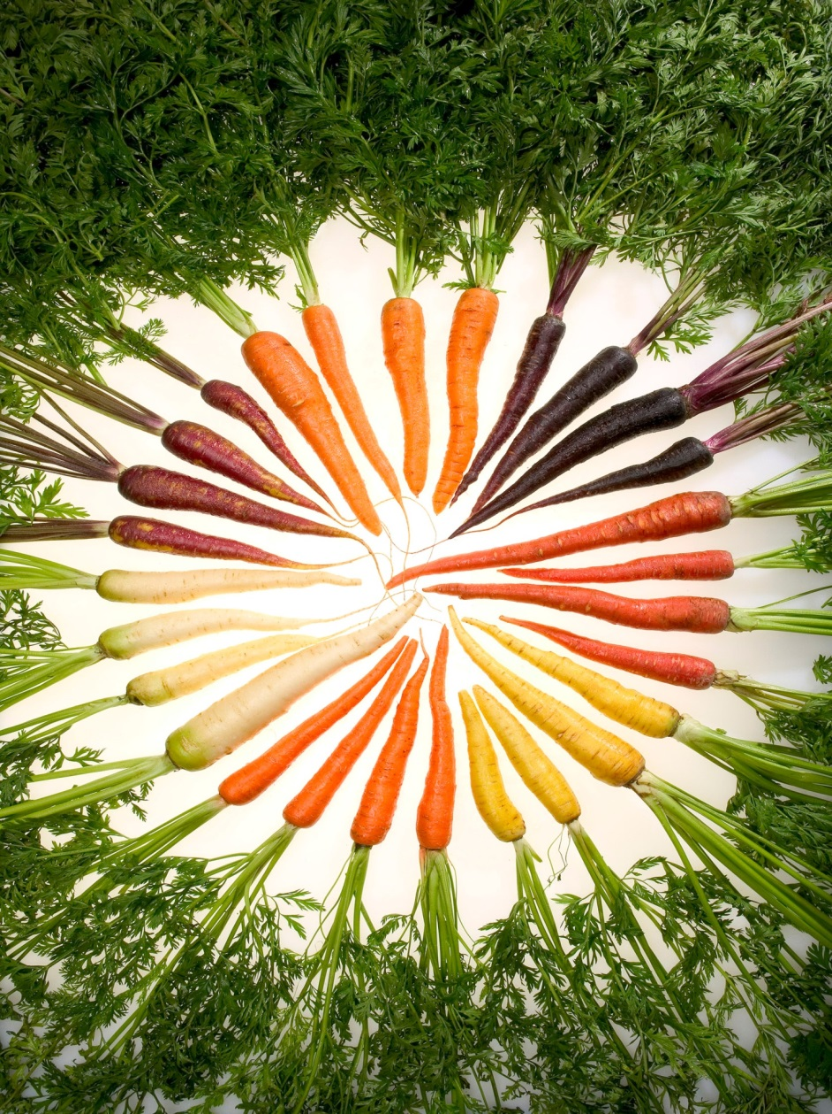
Thank you !

