Slide 1
Drought Tolerance
Carrot SCRI Project
SCRI I Progress & SCRI II Plans
Phil Simon & Allen Van Deynze
USDA-ARS/Univ. Wisconsin & Univ. California - Davis

Slide 2
Impact of drought on carrot production
Irrigation water availability is increasingly more limited and expensive
Drought consequences
  Reduced plant growth
  Reduced quality

Slide 3
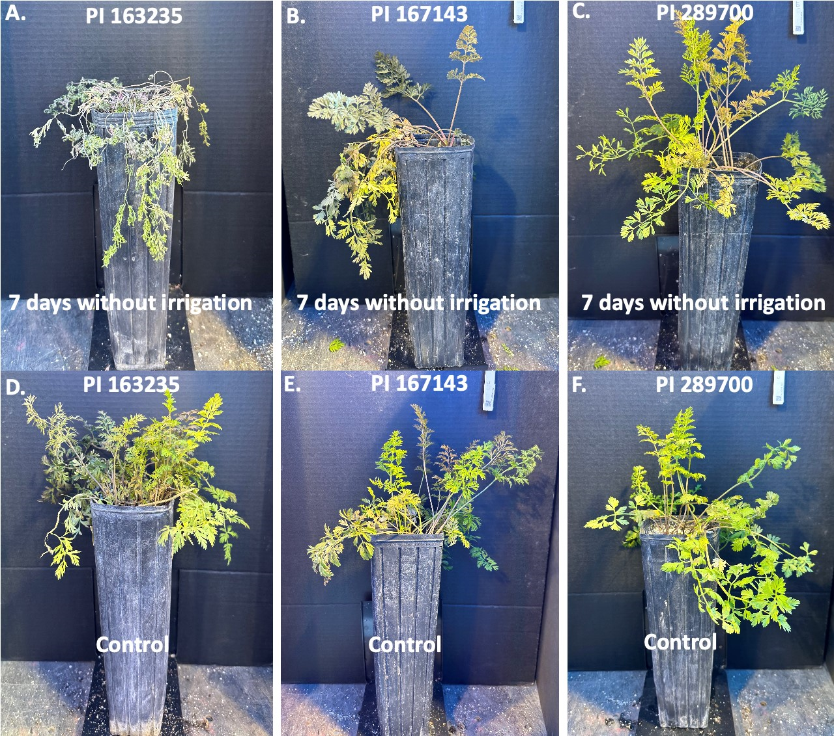
Seven days without (top row) and with (bottom row) irrigation for 3 carrot PIs

Slide 4
Year 1 – BP 1
Year 2 – BP 2
Year 3 – BP 3
ElitePI-2
ElitePI-5
ElitePI-8
Elite PI-1
Elite PI-4
Elite PI-7
x
x
x
Elite PI-3
Elite PI-6
Elite PI-9
Combine Breeding Pools over multiple years of evaluation
Years 4-5 evaluations
Objective 1 traits
Alternaria
resistance
Flavor
Etc.
Breeding pool development and evaluation strategy

Slide 5
Drought Tolerance
Carrot SCRI 2016-2021
Carrot SCRI 2022-2026
700 PIs evaluated by Phil Roberts in the field and greenhouse
199 PIs evaluated in greenhouse by Phil Simon
  Wilting severity, chlorophyll & flavonoid content, gas exchange for stomatal conductance, photosynthesis and water use efficiency
  Recovery after 7 days without water
  Root weight, pigment content
  Transcriptome in a subset
Evaluate mapping pop’ns
Incorporate markers into breeding platform
Advance & release breeding pools
Compare greenhouse and field performance
Use GS to predict breeding values

Slide 6
