Slide 1
Alternaria Leaf Blight Screening
Carrot SCRI Project
SCRI I Progress & SCRI II Plans
Phil Simon
USDA-ARS Vegetable Crops Research Unit
Department of Horticulture
University of Wisconsin - Madison

Slide 2
Impact of Alternaria Leaf Blight
The most devastating and economically significant foliar disease of carrots globally and in the US
In areas prone to attack, yield losses with severe infection typically range from 28-74%; 10-40 sprays (Ben-Noon et al. 2001)
  Reduced plant growth
  Weak tops reduce yield with mechanical harvest
No complete resistance, several sources of partial resistance

Slide 3
Materials and Methods
700 PIs evaluated
  At least 3 years
Disease scores ranged from 1.7– 5.0 on 5 point scale
Few scores under 3.0

Slide 4
The development and evaluation of carrot breeding pools
After evaluating PIs and inbreds, elite individuals from diverse genetic sources will be used to develop breeding pools
Selected roots from CA and WA sent to WI
Among selected PIs, elite plants will be intermated with plants of like-performance
  These are the breeding pools
A subset of other phenotyped plants will be self-pollinated
  To establish a collection of families for subsequent phenotyping and genetic analysis

Slide 5
Year 1 – BP 1
Year 2 – BP 2
Year 3 – BP 3
ElitePI-2
ElitePI-5
ElitePI-8
Elite PI-1
Elite PI-4
Elite PI-7
x
x
x
Elite PI-3
Elite PI-6
Elite PI-9
Combine Breeding Pools over multiple years of evaluation
Years 4-5 evaluations
Objective 1 traits
Alternaria
resistance
Flavor
Etc.
Breeding pool development and evaluation strategy

Slide 6
Breeding pools under development
Alternaria leaf blight resistance
Top size
Flavor
Carotenoids
Elite selections being developed
  Nematode resistance
  Flavor
  Sugars
  Carotenoids, anthocyanins

Slide 7
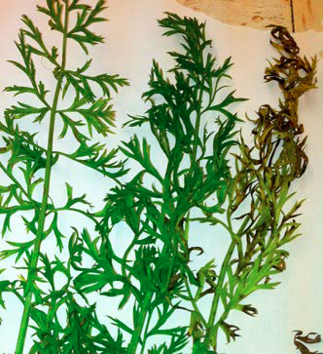
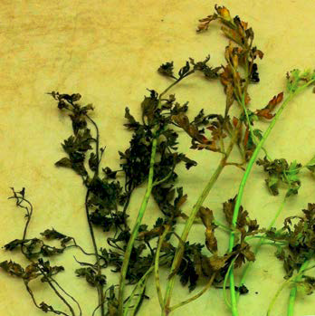
Alternaria Leaf Blight Resistance
Carrot SCRI 2016-2021
750 entries evaluated > 4 years
Disease scores ranged from 1.7– 5.0 on 5 point scale
Few scores under 3.0
Breeding pools established
Carrot SCRI 2022-2026
Evaluate mapping pop’ns
Incorporate markers into breeding platform
Advance & release breeding pools
Use GS to predict breeding values
Scores of 2 (left) and 5 (right) on a 5 point scale

Slide 8
