Slide 1


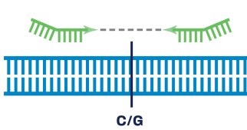
SREP2: Obj. 1 Plan & updates
1c. Developing the carrot Genotyping Platform
1a. Developing the carrot pangenome
1b. Compiling a SNP catalog
Carrot pop 1-6 represent Genome 1…25
(De-novo assembly)
Carrot available genomes (DH1)
Detect SNPs (de-novo) using:
Pangenome sequences (see 1a.2)
Other sequence sources (Carrot SREP 1)
SNP selection criteria:
Gene-based (required)
Evenly distributed in the genome (~90 Kb from each other)
Core genome (majority desired)
Genome specific (PAV, CNV desired)
QTL SNPs (desired)
Haplotype specific (required)
Specific gene families (such , resistance genes, carotenoid… )
1. Pangenome analysis
1. Develop a SNP catalog:
De-novo SNP set
Existing SNP set
a) Linkage map SNPs
b) QTL/GWAS SNPs
Accessory
genes
Unique and
Pop. specific genes
Core genes
2. Carrot Genotyping Forum
Who:
- Industry stakeholders
- Scientists
- Genotyping service providers
Topics:
- Technical feasibility
- Throughput
c) No. samples (carrot community wide)
d) Costs-budget
e) Timeline
f) Criteria for SNP selection
g) Complete material selection
Carrot genotyping platform validation (15,000 probes)
How: SeqCatpure platform
What: 576 carrot samples
Pangenome
2. Comparative genome analysis
SV
Probe 1…. 15,000
SNP
Structural Variants (Deletion/Insertions)
SNPs and Indels
Duplications
 | SNPs | Haplotype
Sample 1 | 1 0 2 2 | 1 2
Sample n | 2 2 1 1 | 1
Presence Absence Variant (PAV)
Copy Number Variants (CNV)

Slide 2
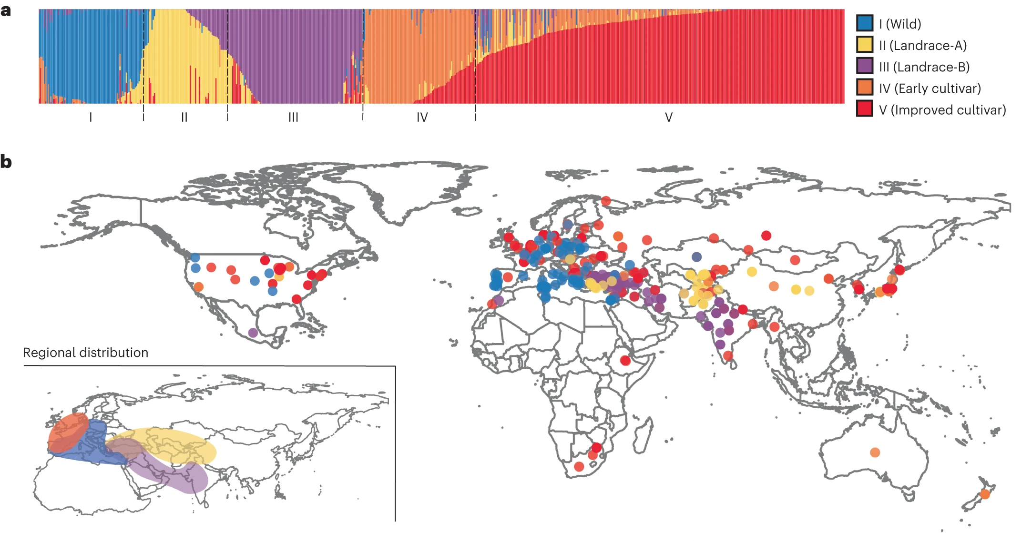
Pangenome samples
1a. Developing the carrot pangenome
Carrot pop 1-6 represent Genome 1…25
(De-novo assembly)
Carrot available genomes (DH1)
1. Pangenome analysis
Accessory
genes
Unique and
Pop. specific genes
Core genes
Pangenome
36 samples:
D. sahariensis
D. carota ssp. capillifolius
D. carota ssp. gummifer
Wild D. carota ssp carota: 3
Landrace A: 4
Landrace B: 8
Early cultivar: 6
Improved cultivar: 8
TBD: 4

Slide 3
Pangenome samples
S. No. | PI_name | PI_info | Majority | Pangenome Code | Skin/ Periderm | Cortex | Phloem | Xylem | Petiole
1 | NSL 6193 | SELECT DANVERS 247P United States | Improve Cultivar 1 | 1 | O | O | O | O | G
2 | PI 632390 | Long Imperator II United States | Improve Cultivar 1 | 2 | O | O | O | O | G
3 | PI 264233 | Claudia (Earliest Nantes) France | Improve Cultivar 1 | 4 | O | O | O | O | G
4 | PI 261649 | Flakheese Netherlands | Early Cultivar | 6 | O | O | O | O | G
5 | PI 643114 | White Belgian United States | Early Cultivar | 8 | W | W | W | W | G
6 | PI 540419 | Mirzoe Mushtak Uzbekistan | Improve Cultivar 1 | 9 | Y | Y | Y | Y | G
7 | PI 220517 | Zardak (Carrot) Afghanistan | Landrace_A | 14 | Y | Y | Y | P | P
8 | PI 164484 | Gajar India | Landrace_B1 | 16 | P | P | W | W | P
9 | PI 652257 | Pusa Meghali India | Landrace_B1 | 17 | O | O | O | O | G
10 | PI 652136 | Shin Kuroda Gosun Japan | Improve Cultivar 1 | 19 | O | O | O/P | O | G
11 | PI 264543 | Kintoki Japan | Landrace_A | 20 | R | R | O | O | G
12 | PI 652188 | Ping Ding China | Landrace_A | 21 | P | O | O | O | P
13 | Ames 26383 | D. carota ssp. gummifer Portugal | Wild SSP (Wild) | 23 | W | W | W | W | P
14 | PI 279764 | D. carota ssp. capillifolius Libya | Wild SSP (Wild ssp2) | 24 | W | W | W | W | P
15 | 06'E639-1 | Brasï¿½lia | Mixed | 29 | O | O | O | O | G
16 | 15'B118ï¿½1 | B2566 | Improved Cultivar 2 | 30 | O | O | O | O | G
17 | 15'B122-1 | B7262 | Improved Cultivar 2 | 31 | P | P | P | O | P
18 | Ames 32056 | Morocco | Improved Cultivar 2 | 33 | O | O | Y | Y | G
19 | Ames 29084 | 19 Tunisia | Landrace_B3 | 34 | O | O | O | O | G
20 | PI 652402 | T123 Turkey | Landrace_B2 | 36 | O | O | Y | O | G
21 | PI 175717 | 9114 Turkey | Landrace_B2 | 38 | W | W | W | W | G
22 | PI 344447 | 250 Iran | Landrace_B2 | 39 | Y | Y | Y | Y | G
23 | PI 652256 | IIHR 196 India | Landrace_B1 | 41 | O | O | Y | Y | G
24 | PI 652198 | 8382-1 Germany | Wild | 44 | W | W | W | W | G
25 | PI 164461 (Gajar India | Gajar India | Early Cultivar | 46 | O | O | O | O | G
26 | PI 285622 | Lobberychska SWHN Poland | Early Cultivar | 47 | Y | Y | Y | Y | G
27 | PI 256065 | 1 Afghanistan | Early Cultivar | 48 | O | O | Y | Y | G
28 | PI 522176 | Benifuku Harumaki 5 Sun Japan | Early Cultivar | 49 | O | O | O | O | G
29 | AP (7-2) | 3repeat - UK 13:011201 Afghan Purple | - | 52 | P | P | P | W | P
30 | Ames 25040 | Pusa Kesar India | Landrace_B1 | 50 | P | P | P | P | P
31 | Ames 27400 | Z021 Uzbekistan | Landrace_A | 53 | P | P | O | O | P
32 | Lunar White | Lunar White | 0 | LW | W | W | W | W | G
33 | Deep Purple | Deep Purple | #N/A | DPP | P | P | P | P | P
34 | Ames 29086 (Tunisia) | Tunisia | Wild | 54 (Tunisia) | W | W | W | W | G
35 | Ames 29096 (sahriensis) | D. sahariensis Tunisia | Wild SP (Wild ssp 3) | 28 | W | W | W | W | G
36 | PI 652237 | Syria | wild | Syr | W | W | W | W | G
Other possible additions:
Nematode resistant and susceptible (2)
Red carrot (1)

Slide 4
Genome assemblies and annotation strategy
PacBio + Hi-C samples (6)
PacBio samples (30)
PacBio data
HiFiasm
Assembly
(consensus, haplotype1 & 2)
PacBio data
HiFiasm
Hi-C data + HiFiasm
Assembly
(consensus, haplotype1 & 2)
Scaffolding
JuiceBox
Assembly corrections
Scaffolding
Final assembly
Final assembly
Repeat prediction annotation
Repeat prediction annotation
Transcriptome data (root, petiole, leaf, flower germ. Seeds) (Illumina)
Transcriptome data (root, petiole, leaf, flower germ. Seeds) (Illumina)
Genomic features prediction and annotation
Genomic features prediction and annotation

Slide 5
Genomic DNA Sequencing status
Hi-C
Sequenced
To be sequenced
PacBio HiFi
S. No. | PI_name | PI_info | Majority | Pangenome Code | Skin/ Periderm | Cortex | Phloem | Xylem | Petiole
1 | NSL 6193 | SELECT DANVERS 247P United States | Improve Cultivar 1 | 1 | O | O | O | O | G
2 | PI 632390 | Long Imperator II United States | Improve Cultivar 1 | 2 | O | O | O | O | G
3 | PI 264233 | Claudia (Earliest Nantes) France | Improve Cultivar 1 | 4 | O | O | O | O | G
4 | PI 261649 | Flakheese Netherlands | Early Cultivar | 6 | O | O | O | O | G
5 | PI 643114 | White Belgian United States | Early Cultivar | 8 | W | W | W | W | G
6 | PI 540419 | Mirzoe Mushtak Uzbekistan | Improve Cultivar 1 | 9 | Y | Y | Y | Y | G
7 | PI 220517 | Zardak (Carrot) Afghanistan | Landrace_A | 14 | Y | Y | Y | P | P
8 | PI 164484 | Gajar India | Landrace_B1 | 16 | P | P | W | W | P
9 | PI 652257 | Pusa Meghali India | Landrace_B1 | 17 | O | O | O | O | G
10 | PI 652136 | Shin Kuroda Gosun Japan | Improve Cultivar 1 | 19 | O | O | O/P | O | G
11 | PI 264543 | Kintoki Japan | Landrace_A | 20 | R | R | O | O | G
12 | PI 652188 | Ping Ding China | Landrace_A | 21 | P | O | O | O | P
13 | Ames 26383 | D. carota ssp. gummifer Portugal | Wild SSP (Wild) | 23 | W | W | W | W | P
14 | PI 279764 | D. carota ssp. capillifolius Libya | Wild SSP (Wild ssp2) | 24 | W | W | W | W | P
15 | 06'E639-1 | Brasï¿½lia | Mixed | 29 | O | O | O | O | G
16 | 15'B118ï¿½1 | B2566 | Improved Cultivar 2 | 30 | O | O | O | O | G
17 | 15'B122-1 | B7262 | Improved Cultivar 2 | 31 | P | P | P | O | P
18 | Ames 32056 | Morocco | Improved Cultivar 2 | 33 | O | O | Y | Y | G
19 | Ames 29084 | 19 Tunisia | Landrace_B3 | 34 | O | O | O | O | G
20 | PI 652402 | T123 Turkey | Landrace_B2 | 36 | O | O | Y | O | G
21 | PI 175717 | 9114 Turkey | Landrace_B2 | 38 | W | W | W | W | G
22 | PI 344447 | 250 Iran | Landrace_B2 | 39 | Y | Y | Y | Y | G
23 | PI 652256 | IIHR 196 India | Landrace_B1 | 41 | O | O | Y | Y | G
24 | PI 652198 | 8382-1 Germany | Wild | 44 | W | W | W | W | G
25 | PI 164461 (Gajar India | Gajar India | Early Cultivar | 46 | O | O | O | O | G
26 | PI 285622 | Lobberychska SWHN Poland | Early Cultivar | 47 | Y | Y | Y | Y | G
27 | PI 256065 | 1 Afghanistan | Early Cultivar | 48 | O | O | Y | Y | G
28 | PI 522176 | Benifuku Harumaki 5 Sun Japan | Early Cultivar | 49 | O | O | O | O | G
29 | AP (7-2) | 3repeat - UK 13:011201 Afghan Purple | - | 52 | P | P | P | W | P
30 | Ames 25040 | Pusa Kesar India | Landrace_B1 | 50 | P | P | P | P | P
31 | Ames 27400 | Z021 Uzbekistan | Landrace_A | 53 | P | P | O | O | P
32 | Lunar White | Lunar White | 0 | LW | W | W | W | W | G
33 | Deep Purple | Deep Purple | #N/A | DPP | P | P | P | P | P
34 | Ames 29086 (Tunisia) | Tunisia | Wild | 54 (Tunisia) | W | W | W | W | G
35 | Ames 29096 (sahriensis) | D. sahariensis Tunisia | Wild SP (Wild ssp 3) | 28 | W | W | W | W | G
36 | PI 652237 | Syria | wild | Syr | W | W | W | W | G
Other possible additions:
Nematode resistant and susceptible (2)
Red carrot (1)

Slide 6
Genome assemblies
Assembled 30 genomes (27 PacBio and 3 PacBio+Hi-C)
 | PG4 |  |  | PG6_HiC |  |  | PG8 |  |  | PG9_HiC |  |  | PG19
 | Consensus | H1 | H2 | Consensus | H1 | H2 | Consensus | H1 | H2 | Consensus | H1 | H2 | Consensus | H1 | H2
Total sequences | 655 | 789 | 287 | 1698 | 1339 | 567 | 914 | 959 | 189 | 2374 | 2162 | 736 | 833 | 897 | 200
Total bases | 525736585 | 481559247 | 454550289 | 538138951 | 491256925 | 464079538 | 536811328 | 487262574 | 474476767 | 546925182 | 519886018 | 473654931 | 511791720 | 494368395 | 436597547
Min sequence length | 14766 | 14766 | 14766 | 9395 | 5516 | 9395 | 5749 | 5749 | 13920 | 5836 | 3286 | 8200 | 16908 | 15783 | 20640
Max sequence length | 49819084 | 46897398 | 49834262 | 63249786 | 58545973 | 50714727 | 87467238 | 70073240 | 76187492 | 54573312 | 55432457 | 54432732 | 58962319 | 54709889 | 44627739
Average sequence length | 802651.27 | 610341.25 | 1583798.92 | 316925.18 | 366883.44 | 818482.43 | 587320.93 | 508094.45 | 2510459.08 | 230381.29 | 240465.32 | 643552.9 | 614395.82 | 551135.33 | 2182987.73
N50 length | 36404150 | 30611798 | 16767635 | 38965885 | 22593812 | 19349999 | 59155697 | 46133939 | 48766218 | 41640568 | 31656613 | 16987299 | 41984078 | 24850910 | 22727875
(A + T)s | 64.50% | 64.49% | 64.54% | 64.79% | 64.85% | 65.06% | 64.64% | 64.71% | 64.67% | 65.35% | 65.54% | 65.31% | 64.61% | 64.59% | 64.65%
(G + C)s | 35.50% | 35.51% | 35.46% | 35.21% | 35.15% | 34.94% | 35.36% | 35.28% | 35.33% | 34.65% | 34.46% | 34.69% | 35.39% | 35.41% | 35.35%
Ns | 0.00% | 0.00% | 0.00% | 0.00% | 0.00% | 0.00% | 0.00% | 0.00% | 0.00% | 0.00% | 0.00% | 0.00% | 0.00% | 0.00% | 0.00%
 | PG20_HiC |  |  | PG24 |  |  | PG29 |  |  | PG36
 | Consensus | H1 | H2 | Consensus | H1 | H2 | Consensus | H1 | H2 | Consensus | H1 | H2
Total sequences | 1361 | 1476 | 357 | 2793 | 2893 | 352 | 1768 | 1891 | 363 | 2562 | 2815 | 422
Total bases | 587483730 | 566915443 | 461338661 | 596794058 | 568087982 | 474787577 | 554511583 | 536833821 | 454934496 | 561690203 | 521318169 | 449796590
Min sequence length | 5691 | 5691 | 11939 | 9731 | 9136 | 13923 | 13189 | 11225 | 18335 | 7600 | 7911 | 13771
Max sequence length | 53288332 | 44563814 | 48940111 | 60902440 | 62809469 | 60709133 | 55929913 | 55929913 | 45028490 | 54462202 | 32401708 | 45165938
Average sequence length | 431655.94 | 384089.05 | 1292265.16 | 213674.92 | 196366.4 | 1348828.34 | 313637.77 | 283888.85 | 1253263.07 | 219238.96 | 185192.96 | 1065868.7
N50 length | 32538626 | 18980896 | 31999975 | 47356346 | 24476234 | 42040261 | 43071824 | 18557693 | 16244107 | 24351476 | 9483947 | 25599196
(A + T)s | 62.12% | 62.20% | 64.17% | 63.57% | 63.52% | 64.86% | 64.36% | 64.39% | 64.52% | 63.68% | 63.57% | 64.49%
(G + C)s | 37.88% | 37.80% | 35.83% | 36.43% | 36.48% | 35.14% | 35.64% | 35.61% | 35.48% | 36.32% | 36.43% | 35.51%
Ns | 0.00% | 0.00% | 0.00% | 0.00% | 0.00% | 0.00% | 0.00% | 0.00% | 0.00% | 0.00% | 0.00% | 0.00%
 | PG39 |  |  | PG47 |  |  | PG53
 | Consensus | H1 | H2 | Consensus | H1 | H2 | Consensus | H1 | H2
Total sequences | 1204 | 1299 | 276 | 431 | 520 | 285 | 1318 | 1430 | 232
Total bases | 515593556 | 478371159 | 424158151 | 507570140 | 448980857 | 460893920 | 536188765 | 509989487 | 444980190
Min sequence length | 4829 | 11782 | 9369 | 4002 | 4002 | 4002 | 7696 | 5970 | 10971
Max sequence length | 57336628 | 47890083 | 57270999 | 44021665 | 37819681 | 30563622 | 58460400 | 58186570 | 54761877
Average sequence length | 428233.85 | 368261.09 | 1536804.89 | 1177656.94 | 863424.72 | 1617171.65 | 406820 | 356636 | 1918018.06
N50 length | 38410438 | 20840892 | 17278994 | 17016625 | 9602393 | 7494044 | 31188738 | 22973029 | 24914760
(A + T)s | 64.43% | 64.33% | 64.78% | 64.67% | 64.71% | 64.76% | 64.04% | 63.97% | 64.74%
(G + C)s | 35.57% | 35.67% | 35.22% | 35.33% | 35.29% | 35.24% | 35.96% | 36.03% | 35.26%
Ns | 0.00% | 0.00% | 0.00% | 0.00% | 0.00% | 0.00% | 0.00% | 0.00% | 0.00%
Contig N50 ranges from 1.9 Mb to 59 Mb
Assembly size: 424 Mb to 568 Mb

Slide 7
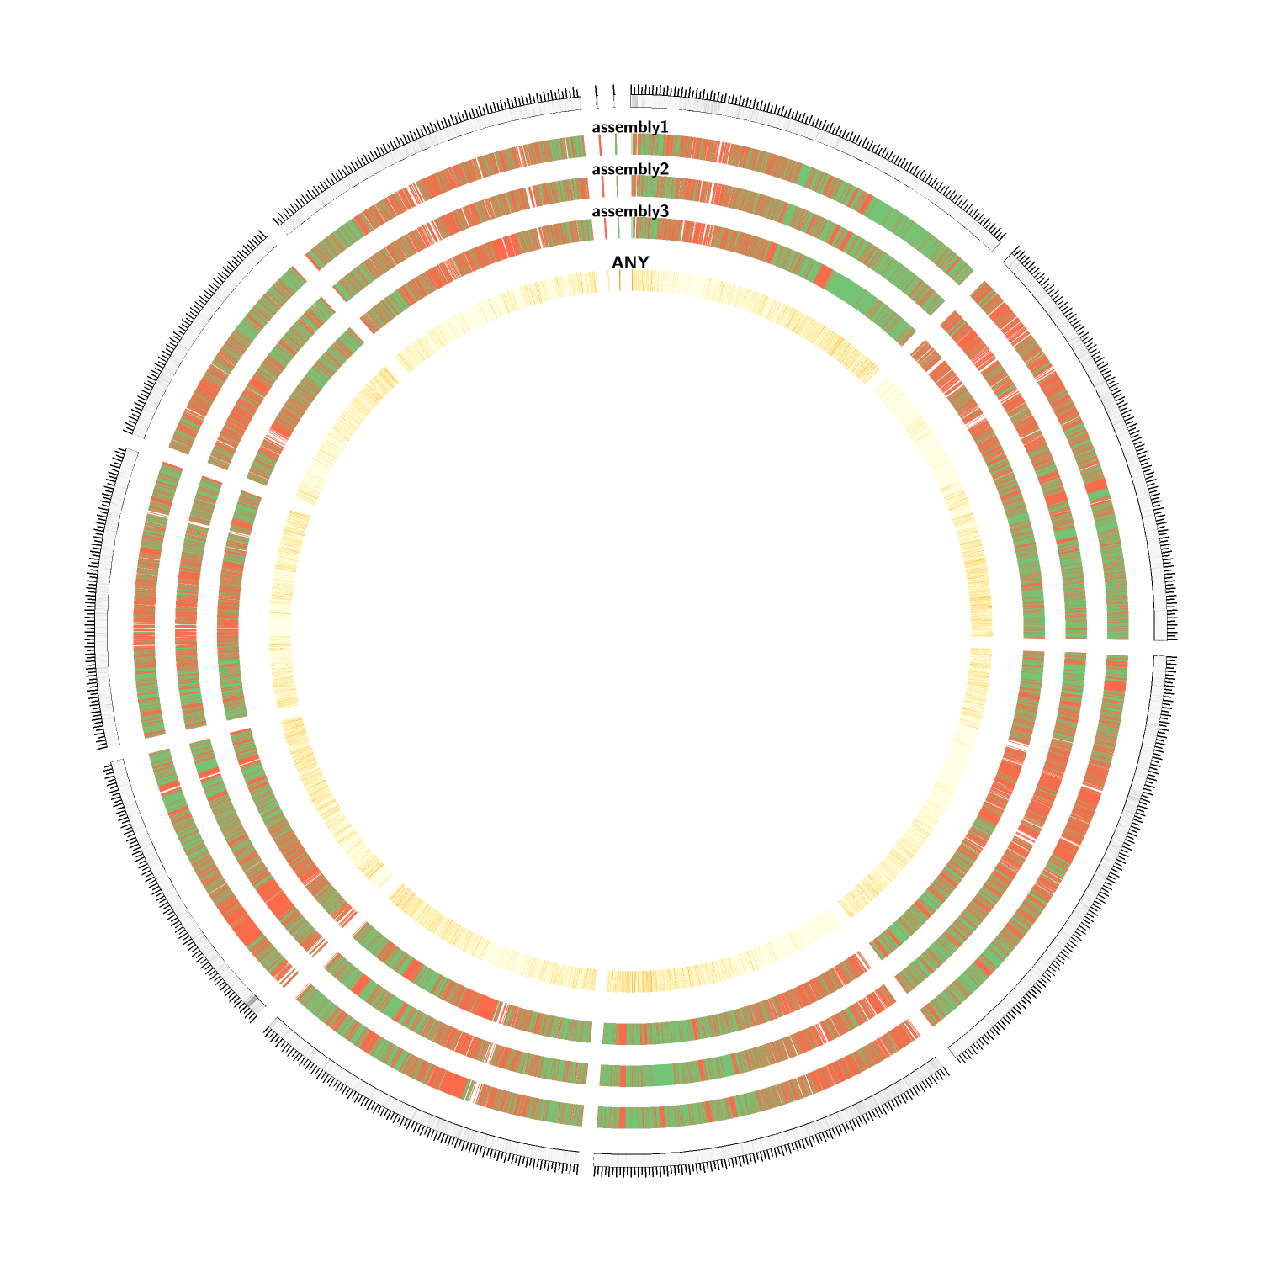
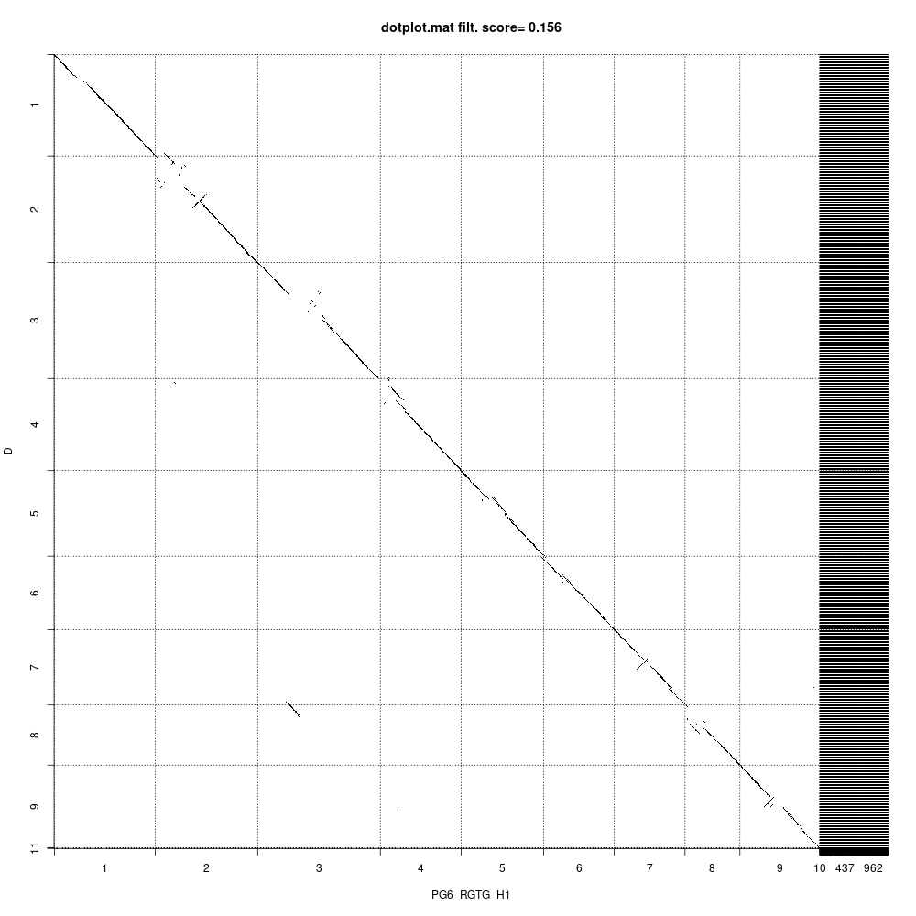
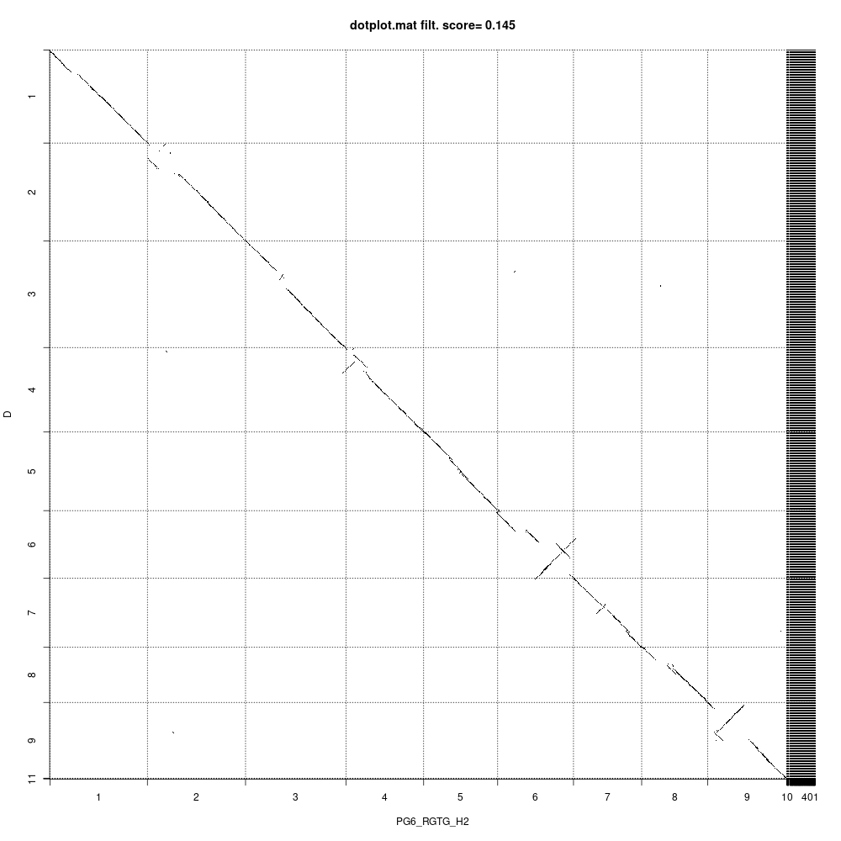
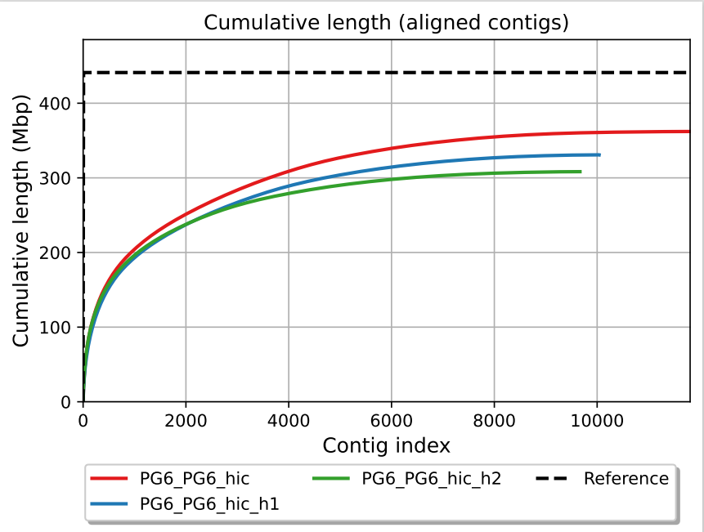
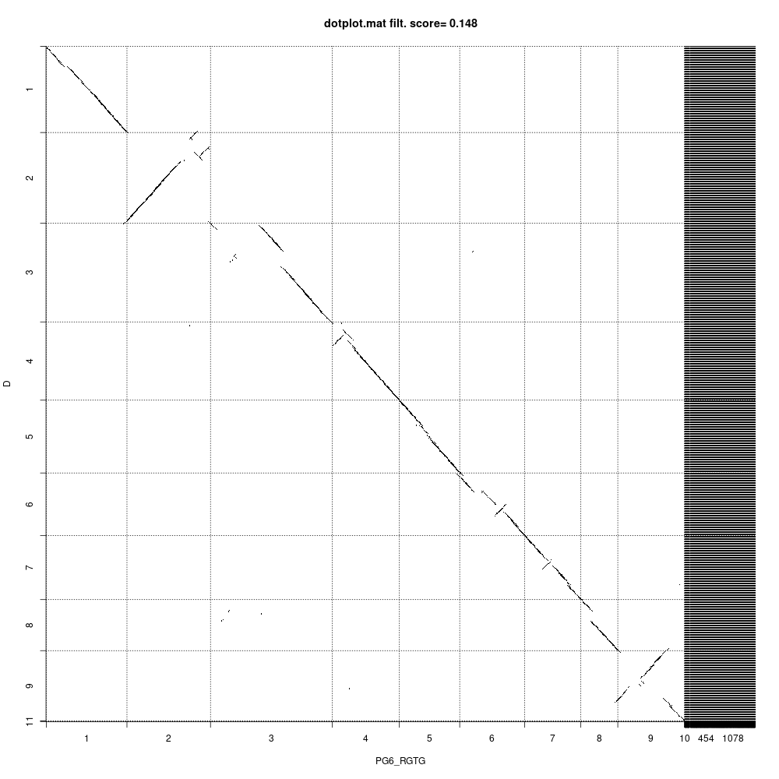
Genome assemblies
PG6 assembly (PacBio + Hi-C)
DCv3
assembly 1 : PG6_consensus
assembly 2 : PG6_Hap1
assembly 3 : PG6_Hap2
DH1 v3
DH1 v3
Hap1 with HiC Data
Hap2 with HiC Data
Assembly | PG6_hic | PG6_hic_h1 | PG6_hic_h2
# contigs | 1698 | 1339 | 567
Total length (>= 0 bp) | 538138951 | 491256925 | 464079538
Largest contig | 63249786 | 58545973 | 50714727
Reference length | 441119532 | 441119532 | 441119532
GC (%) | 35.21 | 35.15 | 34.94
N50 | 38965885 | 22593812 | 19349999
# possible TEs | 684 | 590 | 662
# unaligned mis. contigs | 10 | 17 | 12
Duplication ratio | 1.257 | 1.2 | 1.117
# mismatches per 100 kbp | 826.28 | 881.71 | 909.69
# indels per 100 kbp | 107.56 | 114.67 | 109.3
Largest alignment | 3938251 | 3365064 | 5681550
Total aligned length | 362128812 | 330793901 | 308292257
K-mer-based compl. (%) | 48.4 | 45.61 | 47.37
# k-mer-based misjoins | 1666 | 1663 | 1516
DH1 v3
Consensus with HiC Data

Slide 8
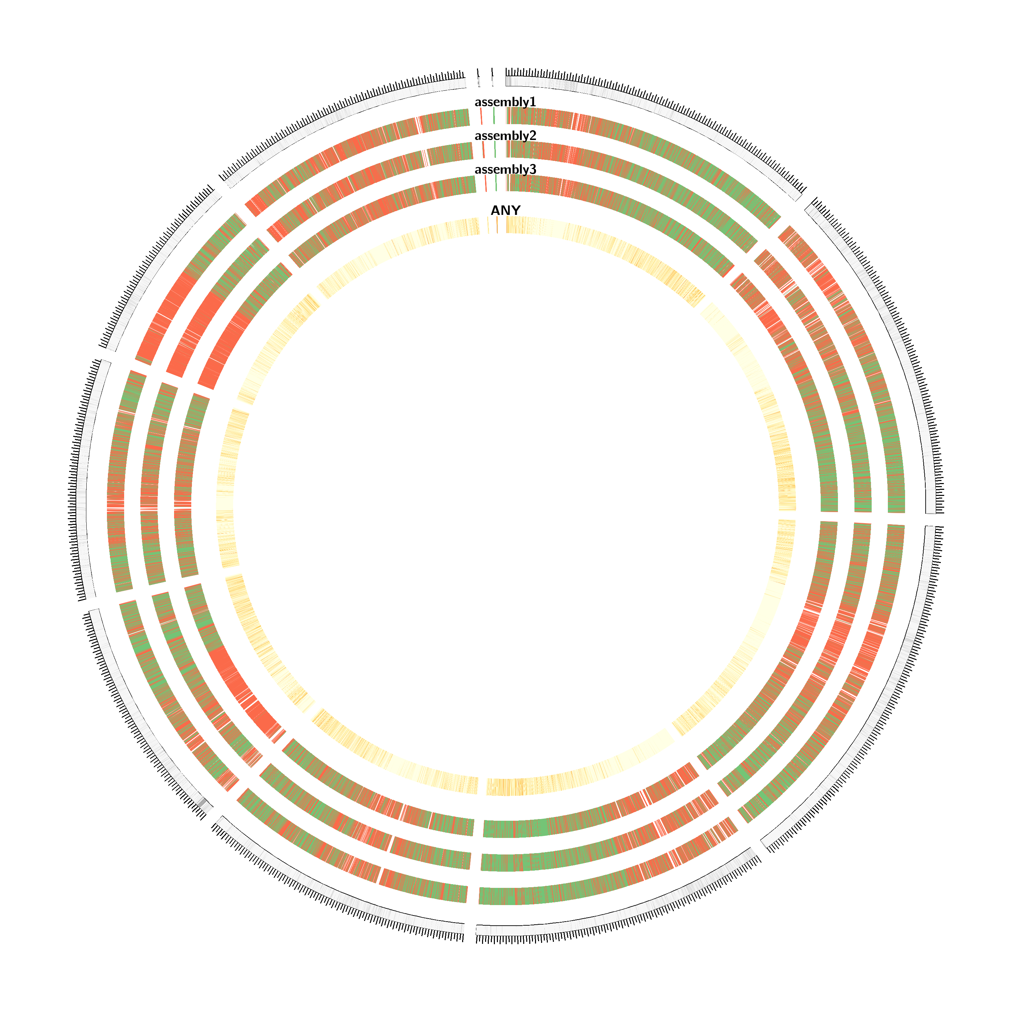
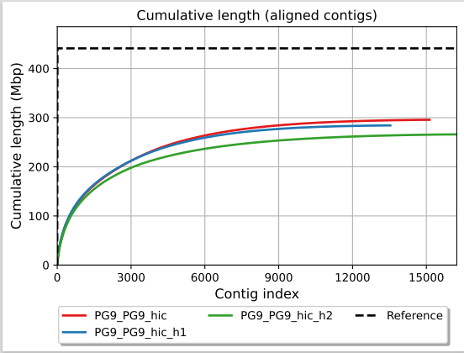
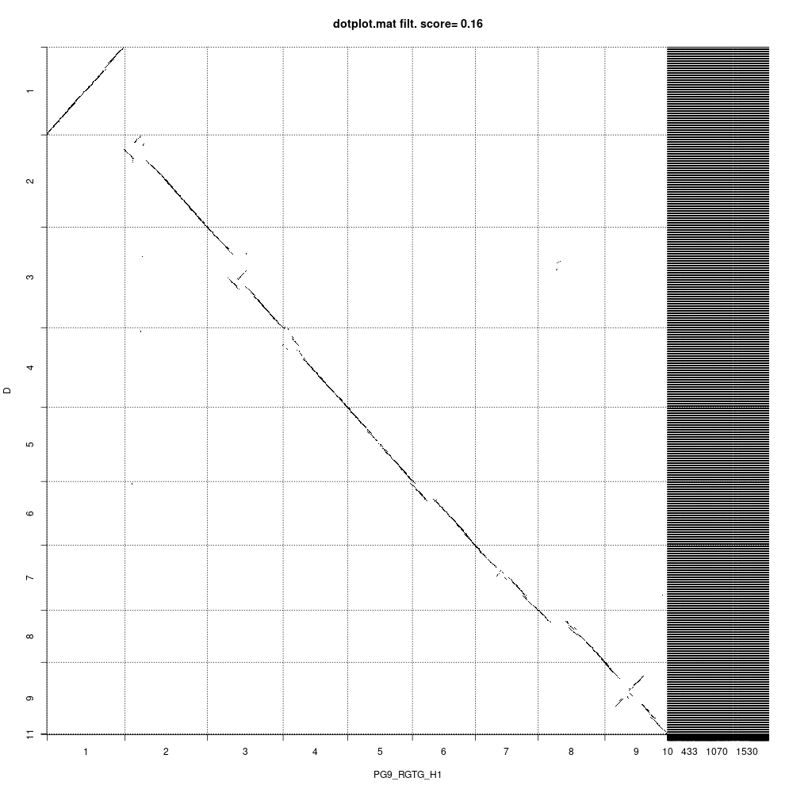
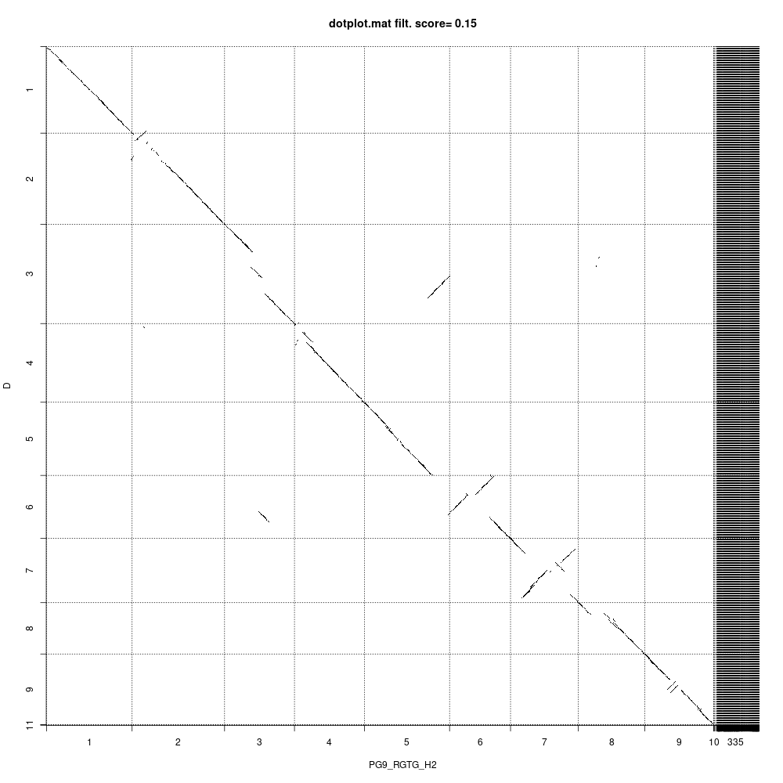
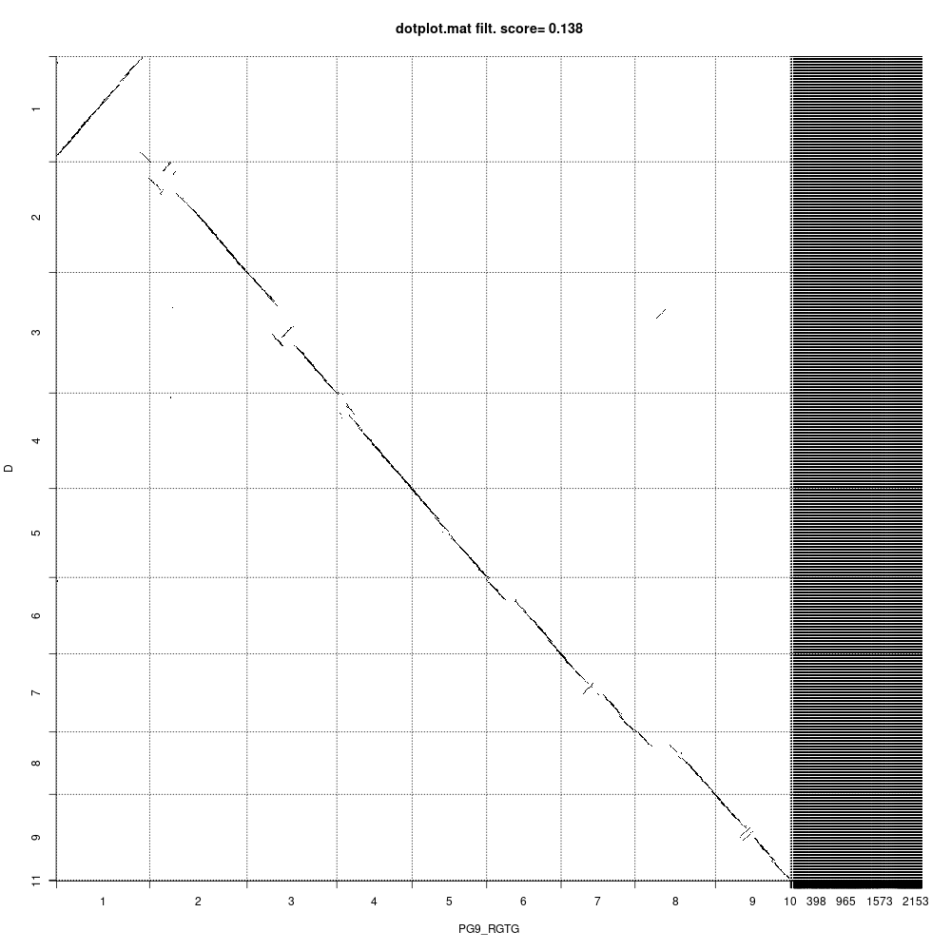
Genome assemblies
PG9 assembly (PacBio + Hi-C)
DCv3
assembly 1 : PG9_consensus
assembly 2 : PG9_Hap1
assembly 3 : PG9_Hap2
DH1 v3
DH1 v3
Hap1 with HiC Data
Hap2 with HiC Data
Assembly | PG9_PG9_hic | PG9_PG9_hic_h1 | PG9_PG9_hic_h2
# contigs | 2374 | 2162 | 736
Total length (>= 0 bp) | 546925182 | 519886018 | 473654931
Largest contig | 54573312 | 55432457 | 54432732
Reference length | 441119532 | 441119532 | 441119532
GC (%) | 34.65 | 34.46 | 34.69
N50 | 41640568 | 31656613 | 16987299
# possible TEs | 724 | 670 | 598
# unaligned mis. contigs | 14 | 14 | 15
Duplication ratio | 1.207 | 1.162 | 1.106
# mismatches per 100 kbp | 1159.94 | 1164.72 | 1267.21
# genomic features | 185019 + 19901 part | 185360 + 19857 part | 184203 + 19889 part
Largest alignment | 1027857 | 1243066 | 1566998
Total aligned length | 295734235 | 284225730 | 266005212
K-mer-based compl. (%) | 33.76 | 34 | 33.08
# k-mer-based misjoins | 1699 | 1622 | 1669
PG9_Consensus with HiC Data
DH1 v3
Consensus with HiC Data

Slide 9
RNA extraction and plans
RNA Extraction from Leaf, Root, Petiole, Flowers and Germinating seeds
Completed RNA extraction from 18 samples from five tissue (root, leaf, petiole, flower, germinating seeds)(90 RNA)
18 samples some tissue need to be extracted
Flower samples required : 6 Pangenomes
Plans
Complete assemblies by the end of summer
Initiated repeat annotation (Poland team): starting in mid August
Initiated RNA sequencing: Starting end of August.
Initiate gene prediction: Otc-November
Complete prediction and annotations: February 2025

Slide 10
Genotyping platform
1c. Developing the carrot Genotyping Platform
1b. Compiling a SNP catalog
Detect SNPs (de-novo) using:
3 genomes (DH1, Lunar White, Deep Purple)
1. Platform selection plan:
SeqCatpure based (DarT)
Applications: QTL mapping (bi-parental) and Genomic selection
Two phases: testing phase (10,000 loci) and genotyping phase (6,000 loci)
1. Develop a SNP catalog:
Existing SNP set
a) QTL/GWAS SNPs (1.6 M SNPs)
Testing phase
384 carrot samples
Genotyping phase: can genotypes up to 25,000 samples
Target price: <15$ sample, include DNA extraction and SNP call
Status: working on contract to start testing phase
Identify conserved genes across genomes and target SNPs in conserved genes
2. Carrot Genotyping consortium
Increase number of samples and lower price for genotyping phase

Slide 11
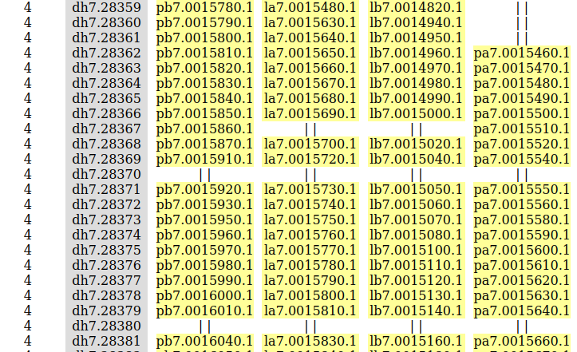
DaRT Gene Selection
Three genomes: DH, Lunar White, Deep Purple
MCScan analysis to find orthologous syntenic genes
Sample output

Slide 12
SNP Selection
Select collinear genes that are not in another MCScan block
  Should be present in all three genomes, and both haplotypes
  ∴ 19,679 genes
Search for isolated SNPs (in progress)
  Align with Muscle, use snp-sites to generate vcf
  Find isolated SNPs not near others
  ∴ 4400 SNPs using isolation distance of 60
Check for even distribution across the genome

Slide 13
Questions?

Slide 14
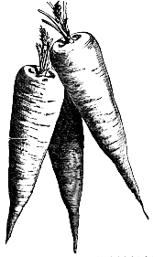
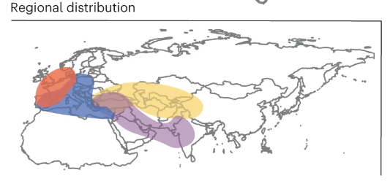
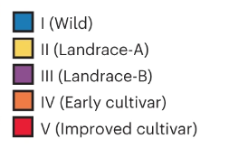

DNA collected to create and validate DArT platform
Efforts from SCRI I resulted in a diverse collection of DNA samples
Landrace-A: 37 samples
Landrace-B: 45 samples
Early Cultivars: 50 samples
Improved Cultivars: 159 samples
Mixed: 91 samples
Flexibility to change for samples of interest

