Slide 1
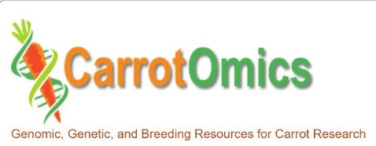
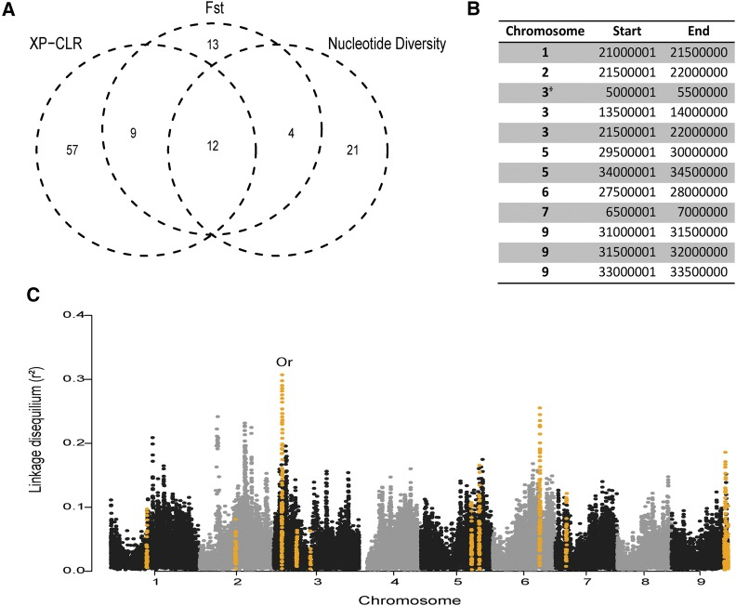
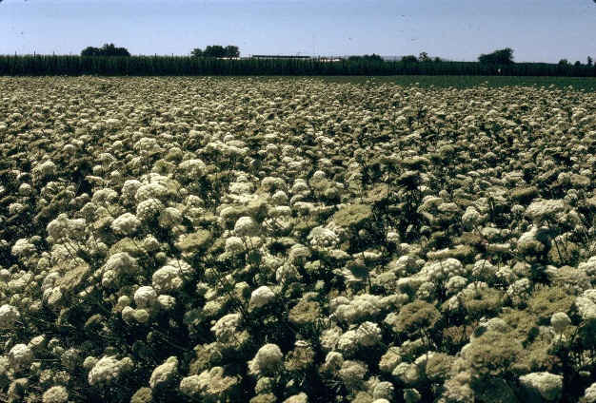
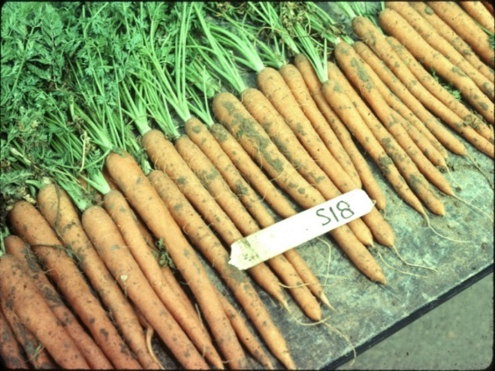
Applying advanced phenotypic and genomic tools to improve flavor, nutrition, and production traits in carrot
Philipp W. Simon
USDA-ARS Vegetable Crops Research Unit
Department of Plant & Agroecosystem Sciences
University of Wisconsin - Madison

Slide 2
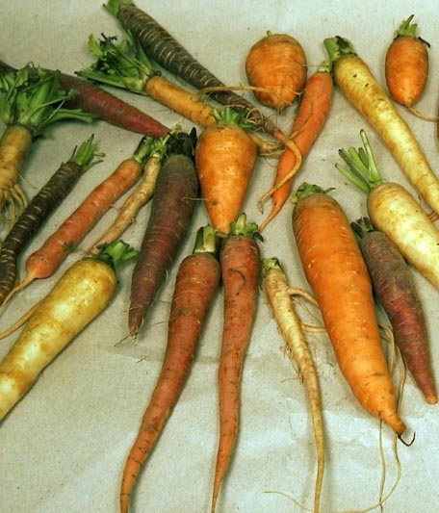
Carrot Germplasm
  ~1100 Plant Introductions in USDA collection, Ames, IA
The ultimate source of natural genetic variation
~650 cultivated
  Old open-pollinated carrots
  Foreign carrots “land races”
~450 wild carrots
Inbreds in public breeding programs

Slide 3
Top Traits for Improvement
2014 Survey; Jan. 9, 2015 stakeholder meeting
1 | Cavity spot | Pests and Disease
2 | Nematodes
3 | Alternaria dauci leaf blight
1 | Sweetness, flavor | Quality and Nutrition
2 | Carotenoids
3 | Anthocyanins
1 | Stand establishment | Production
2 | Bolting tolerance
3 | Drought stress tolerance

Slide 4
Project Organization
18 project investigators and scientists from 10 U.S. institutions
Research and Outreach aspects of each project objective
National Institute of Food and Agriculture, U.S. Department of
Agriculture, under award numbers 2016-51181-25400
and 2022-51181-38321

Slide 5
SCRI 2016-2021
Identifying phenotypes, markers, and genes in carrot germplasm to deliver improved carrots to growers and consumers
Objective 1: Phenotype diverse carrot germplasm and breeding stocks
Objective 2: Develop an expanded carrot genomic database
Objective 3: Initiate development and evaluation of breeding pools
Objective 4: Evaluate carrot pigment health value
Objective 5: Evaluate the economic impacts of new carrot traits
SCRI 2022-2026
Applying advanced phenotypic and genomic tools to improve flavor, nutrition, and production traits in carrot
Objective 1: Develop cost-effective genomic tools
Objective 2: Map gene locations of important traits; initiate genomic selection
Objective 3: Evaluate bioavailability of nutrients
Objective 4: Estimate economic costs and benefits

Slide 6
Applying advanced phenotypic and genomic tools to improve flavor, nutrition, and production traits in carrot
Time | Presenter | Topic
5 | Phil Simon | Agenda, and Project Overview
Objective 1: Develop cost-effective genomic tools
10 | Massimo Iorizzo | Pangenome and comparative genome analysis
10 | Massimo Iorizzo, Allen Van Deynze | Genotyping platform
5 | Advisory Panel Members | Panel questions and input
Objective 2: Map gene locations of economically important traits
5 | Phil Roberts | Root-knot nematode resistance
5 | Phil Simon | Alternaria leaf blight resistance
5 | Phil Simon & Allen Van Deynze | Drought tolerance
5 | Phil Simon & Julie Dawson | Flavor, pigments, and sugars
5 | Julie Dawson & Phil Simon | Stand establishment & carrot growth
5 | Allen Van Deynze | Bolting tendency
5 | Lindsey du Toit | Cavity spot resistance
5 | Julie Dawson | Genomic selection
10 | Advisory Panel Members | Panel questions and input
Objective 3: Evaluate bioavailability of carrot nutrients
10 | Sherry Tanumihardjo | Bioavailability of carrot nutritional value
5 | Advisory Panel Members | Panel questions and input
Obj. 4: Estimate economic costs/benefits of improved traits to buyers & industry
10 | Dan Sumner | Evaluating economic value of new traits
5 | Advisory Panel Members | Panel questions and input
Public Outreach Activities for Carrot SCRI Project
10 | Stacey Amparano, Allen Van Deynze, Micaela Colley, Jas Sidhu, Tim Waters | Outreach activities
5 | Advisory Panel Members | Panel questions and input

Slide 7
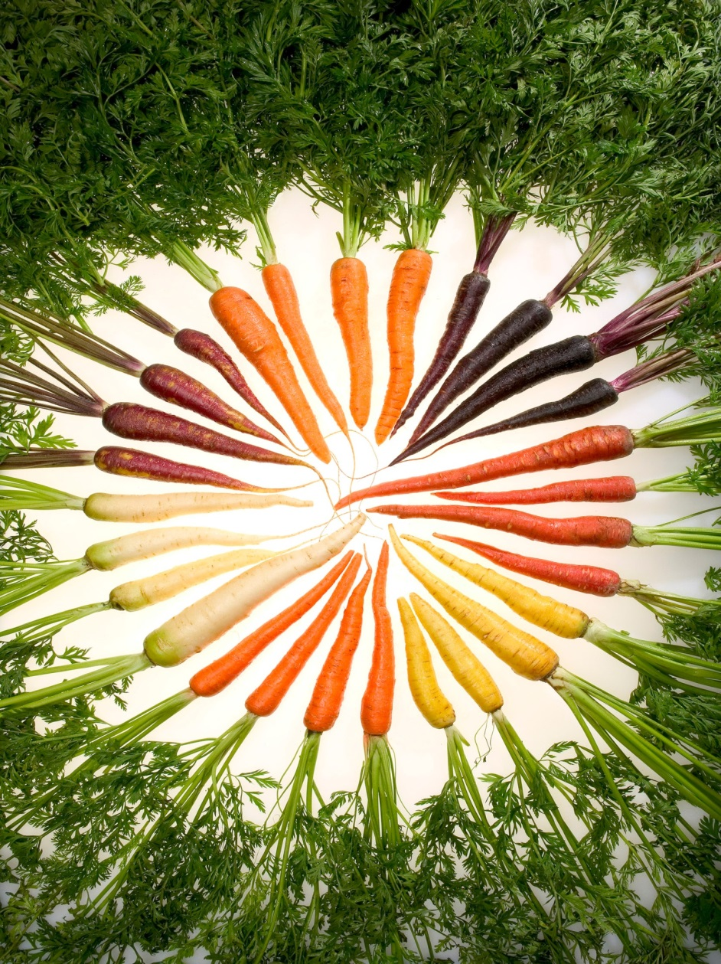
Thank you!

