Slide 1
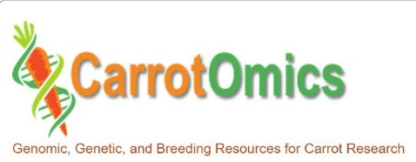
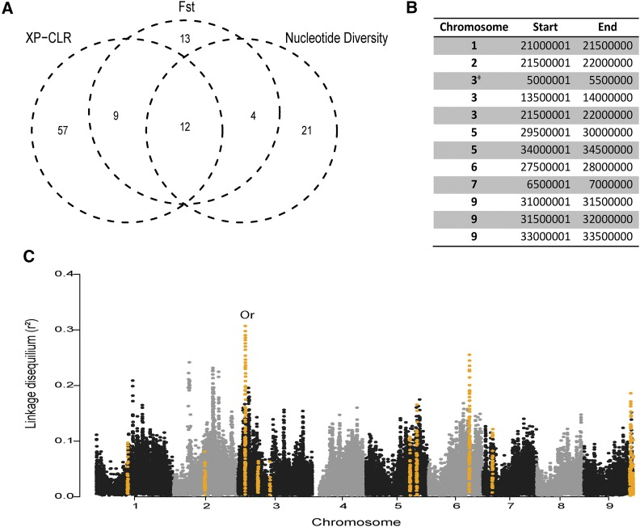
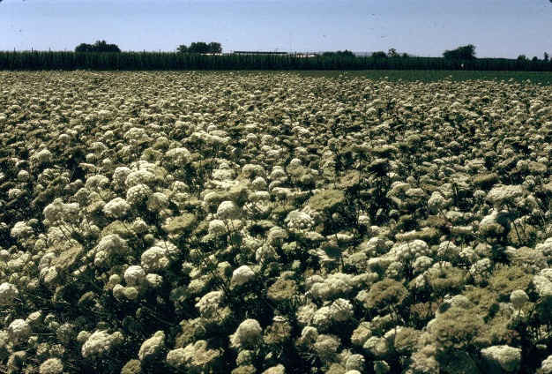
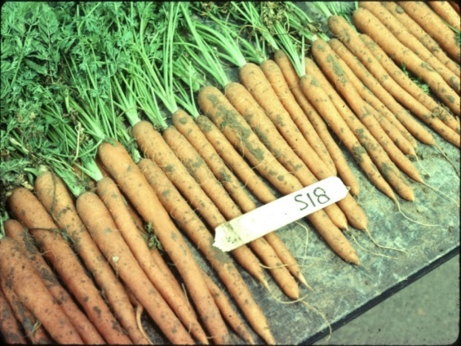
Applying advanced phenotypic and genomic tools to improve flavor, nutrition, and production traits in carrot
U.S. Department of Agriculture
National Institute of Food and Agriculture
Specialty Crops Research Initiative Award 2022-51181-38321

Slide 2
Project Organization
Project directors and scientists from 10 U.S. institutions
Massimo Iorizzo - North Carolina State University
Julie Dawson - University of Wisconsin - Madison
Sherry Tanumihardjo - University of Wisconsin - Madison
Allen Van Deynze - University of California - Davis
Daniel Sumner - University of California - Davis
Philip Roberts - University of California - Riverside
Lindsey du Toit – Washington State University
Micaela Colley – Organic Seed Alliance
Jaspreet Sidhu - University of California - Extension
Jairo Diaz - University of California - Extension
Timothy Waters – Washington State University – Extension
Philipp Simon – USDA, Agricultural Research Service

Slide 3
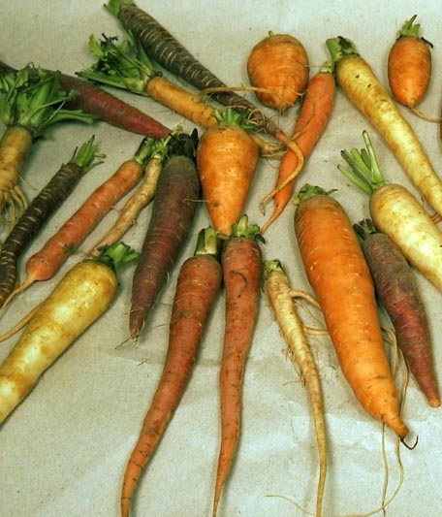
Carrot Germplasm
  ~1100 Plant Introductions in USDA collection, Ames, IA
The ultimate source of natural genetic variation
~650 cultivated
  Old open-pollinated carrots
  Foreign carrots “land races”
~450 wild carrots
Inbreds in public breeding programs

Slide 4
Top Traits for Improvement
2014 Survey; Jan. 9, 2015 stakeholder meeting
1 | Cavity spot | Pests and Disease
2 | Nematodes
3 | Alternaria dauci leaf blight
1 | Sweetness, flavor | Quality and Nutrition
2 | Carotenoids
3 | Anthocyanins
1 | Stand establishment | Production
2 | Bolting tolerance
3 | Drought stress tolerance

Slide 5
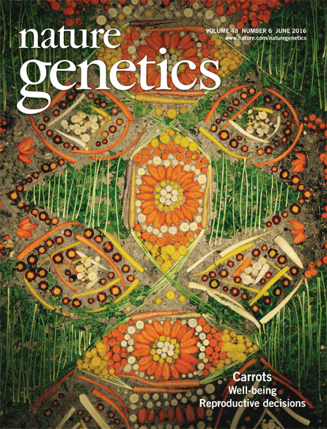
carrot genome published in 2016
A high-quality carrot genome assembly provides new insights into carotenoid accumulation and asterid genome evolution
Massimo Iorizzo, Shelby Ellison, Douglas Senalik, Peng Zeng, Pimchanok Satapoomin, Jiaying Huang, Megan Bowman. Marina Iovene, Walter Sanseverino, Pablo Cavagnaro, Mehtap Yildiz, Alicja Macko-Podgórni, Emilia Moranska, Ewa Grzebelus, Dariusz Grzebelus, Hamid Ashrafi, Zhijun Zheng, Shifeng Cheng, David Spooner, Allen Van Deynze, Philipp Simon
Nature Genetics VOLUME 48
NUMBER 6 | JUNE 2016 657

Slide 6
SCRI 2016-2021
Identifying phenotypes, markers, and genes in carrot germplasm to deliver improved carrots to growers and consumers
Objective 1: Phenotype diverse carrot germplasm and breeding stocks
Objective 2: Develop an expanded carrot genomic database
Objective 3: Initiate development and evaluation of breeding pools
Objective 4: Evaluate carrot pigment health value
Objective 5: Evaluate the economic impacts of new carrot traits
SCRI 2022-2026
Applying advanced phenotypic and genomic tools to improve flavor, nutrition, and production traits in carrot
Objective 1: Develop cost-effective genomic tools
Objective 2: Map gene locations of important traits; initiate genomic selection
Objective 3: Evaluate bioavailability of nutrients
Objective 4: Estimate economic costs and benefits

Slide 7
Applying advanced phenotypic and genomic tools to improve flavor, nutrition, and production traits in carrot
Time | Presenter | Topic
8:30 | Phil Simon | Introductions, Agenda, and Project Overview
Objective 1: Development of cost-effective genomic tools
8:50 | Massimo Iorizzo | Pangenome and comparative genome analysis
9:15 | Massimo Iorizzo, Doug Senalik, Bill Rolling & Allen Van Deynze | Genotyping platform
9:40 | Advisory Panel Members | Panel questions and input
10:00 | Coffee Break
Objective 2: Mapping gene locations of economically important traits
10:20 | Phil Roberts | Root-knot nematode resistance via Zoom
10:40 | Phil Simon | Alternaria leaf blight resistance
11:00 | Mike Derie & Lindsey du Toit | Cavity spot resistance via Zoom
11:20 | Phil Simon & Harun Ar Rashid | Drought tolerance
11:40 | Julie Dawson & Phil Simon | Flavor, pigments, and sugars via Zoom
noon | Lunch provided
1:20 | Julie Dawson & Phil Simon | Stand establishment & carrot growth via Zoom
1:40 | Theresa Hill & Allen Van Deynze | Bolting tendency via Zoom
2:00 | Julie Dawson & Keo Corak | Genomic selection via Zoom
2:20 | Advisory Panel Members | Panel questions and input
2:40 | Coffee Break
Objective 3: Evaluation of bioavailability of carrot nutrients
3:00 | Sherry Tanumihardjo | Bioavailability of carrot nutritional value
3:25 | Advisory Panel Members | Panel questions and input
Obj. 4: Estimation economic costs/benefits of improved traits to buyers & industry
3:40 | Dan Sumner | Evaluating economic value of new traits via Zoom
4:05 | Advisory Panel Members | Panel questions and input
Public Outreach Activities for the Carrot SCRI Project
4:20 | Micaela Colley, Jas Sidhu, Tim Waters, Jairo Diaz, Colin Dixon | Outreach activities via Zoom
4:45 | Advisory Panel Members | Panel questions and input

Slide 8
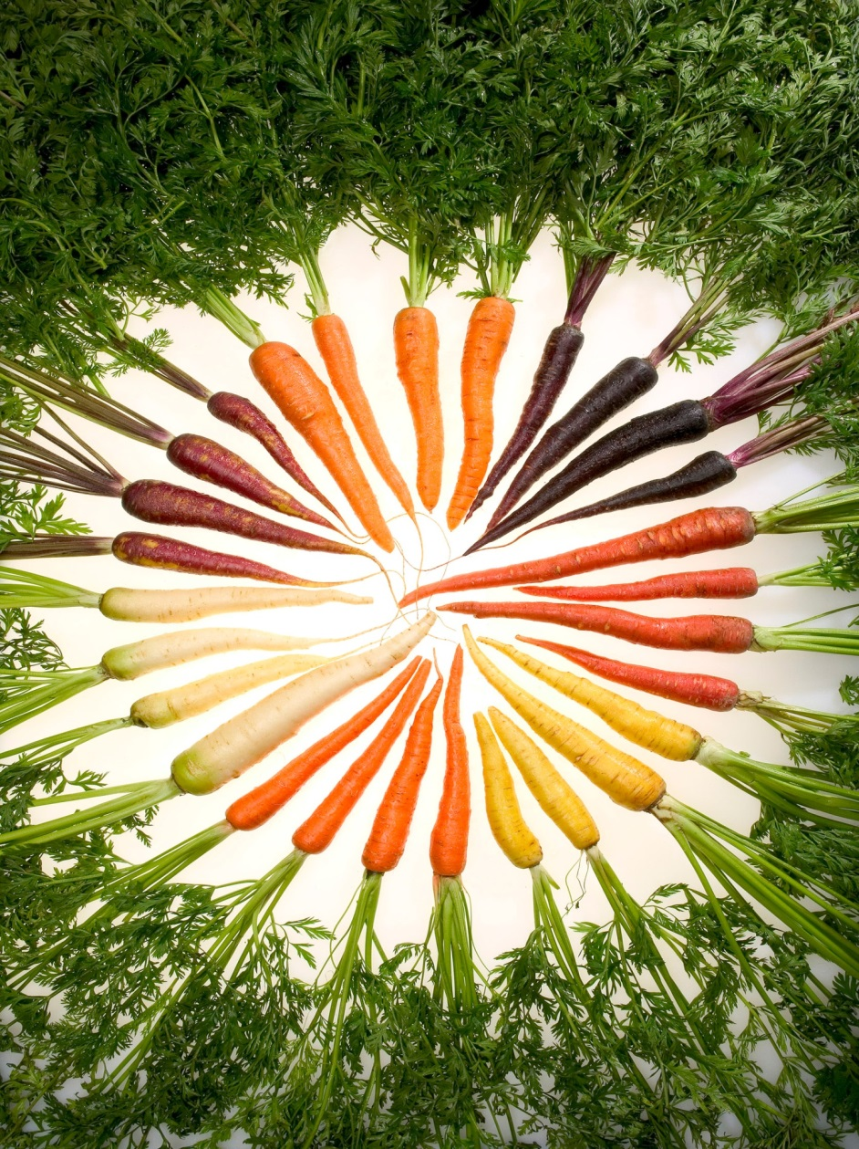
Thank you!

